Slide 1


PDF analysis of nanostructured materials
S.J.L. Billinge
Department of Applied Physics and Applied Mathematics
Columbia University,
CMPMS, Brookhaven National Laboratory

Slide 2
Structure metallic clusters from PDF

Slide 3
Example: DFT can predict structures
DFT is one of the most accurate of the theories (but still approximate)
This is the basis of Materials Prediction, a fundamental of Materials Genomics
Can DFT predict the stable structure of Au nanoparticles?
Yes!

Slide 4
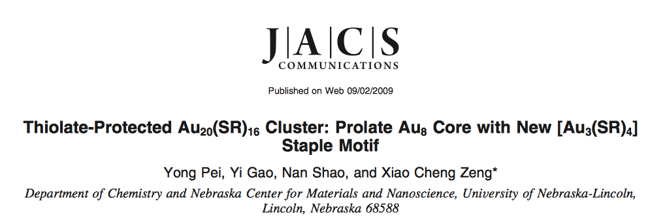
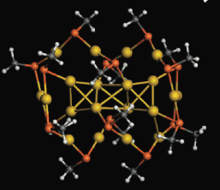
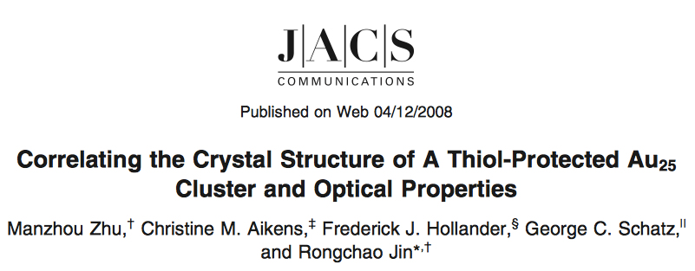
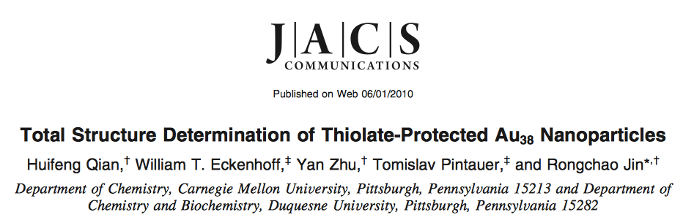
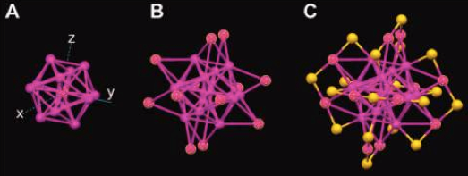
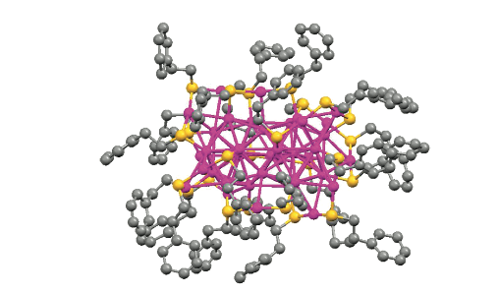
20
25
38

Slide 5
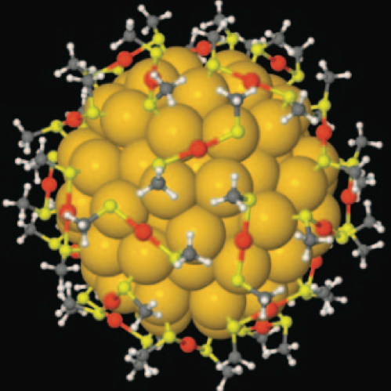
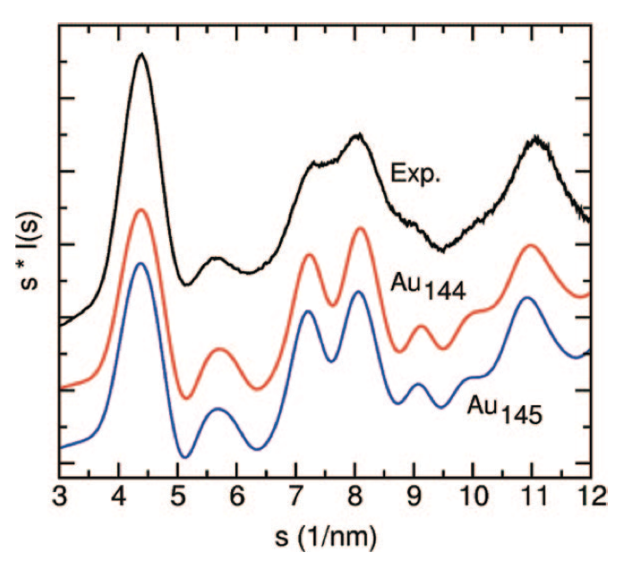

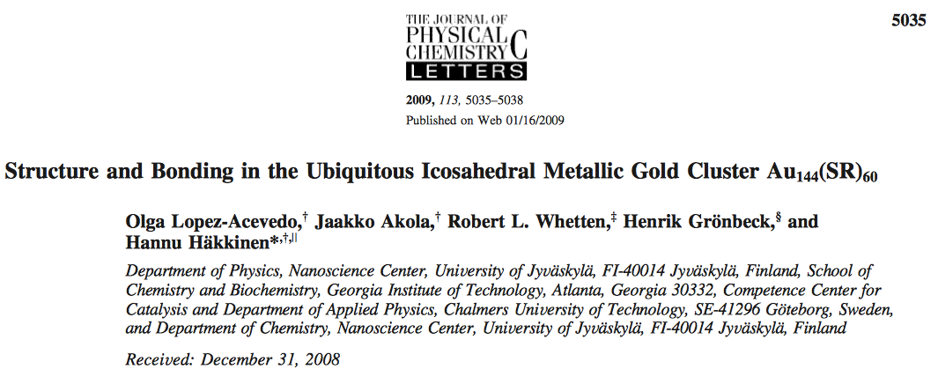
DFT study of Au₁₄₄ structure
Icosahedral core
Au/S surface structure with ligand attachment

Slide 6
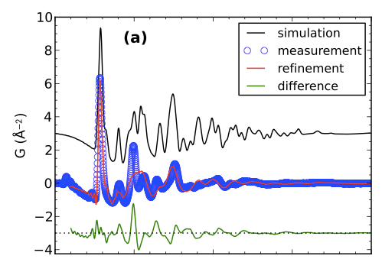
Validate this prediction: Measure X-ray diffraction data (in the form of an atomic pair distribution function (PDF))
PDF simulated from DFT prediction
Blue:Measured PDF
Red:best fit of DFT model
Refinement:
Expansion factor
Thermal parameters for core
Thermal parameters for surface
Correlated motion

Slide 7
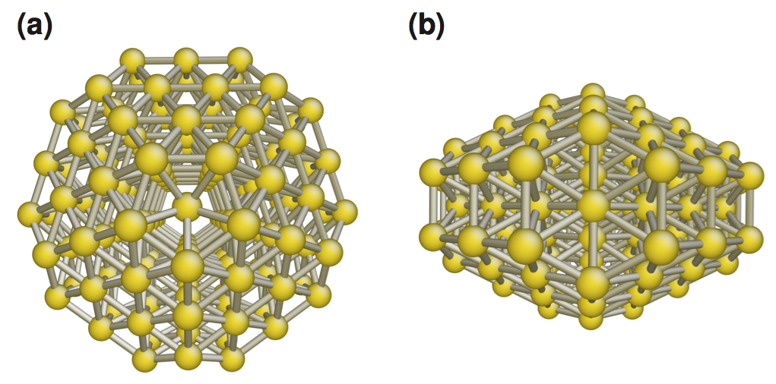
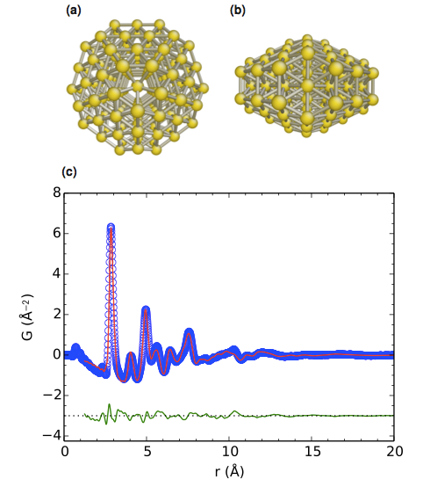
The MD6441 structure: 144 gold atoms
Much better fit from
a Marks decahedral core
From Pavol Juhas

Slide 8
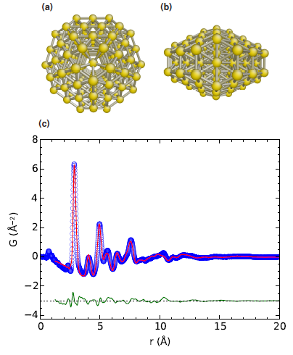
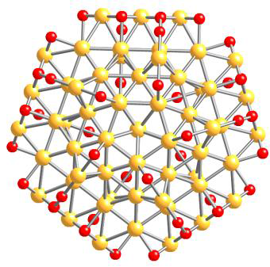
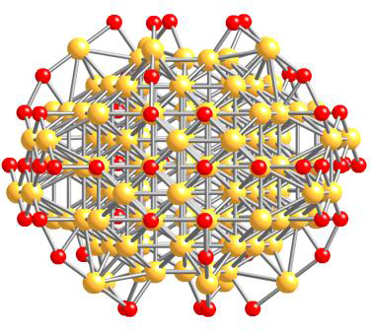
Gold Au144
Proper data validation illustrated theoretical limitation
But our DFT colleagues told us the structural model also had to be incorrect: no low energy Au-thiol staples on the surface
Better (correct?) model had a MD core and staples

Slide 9

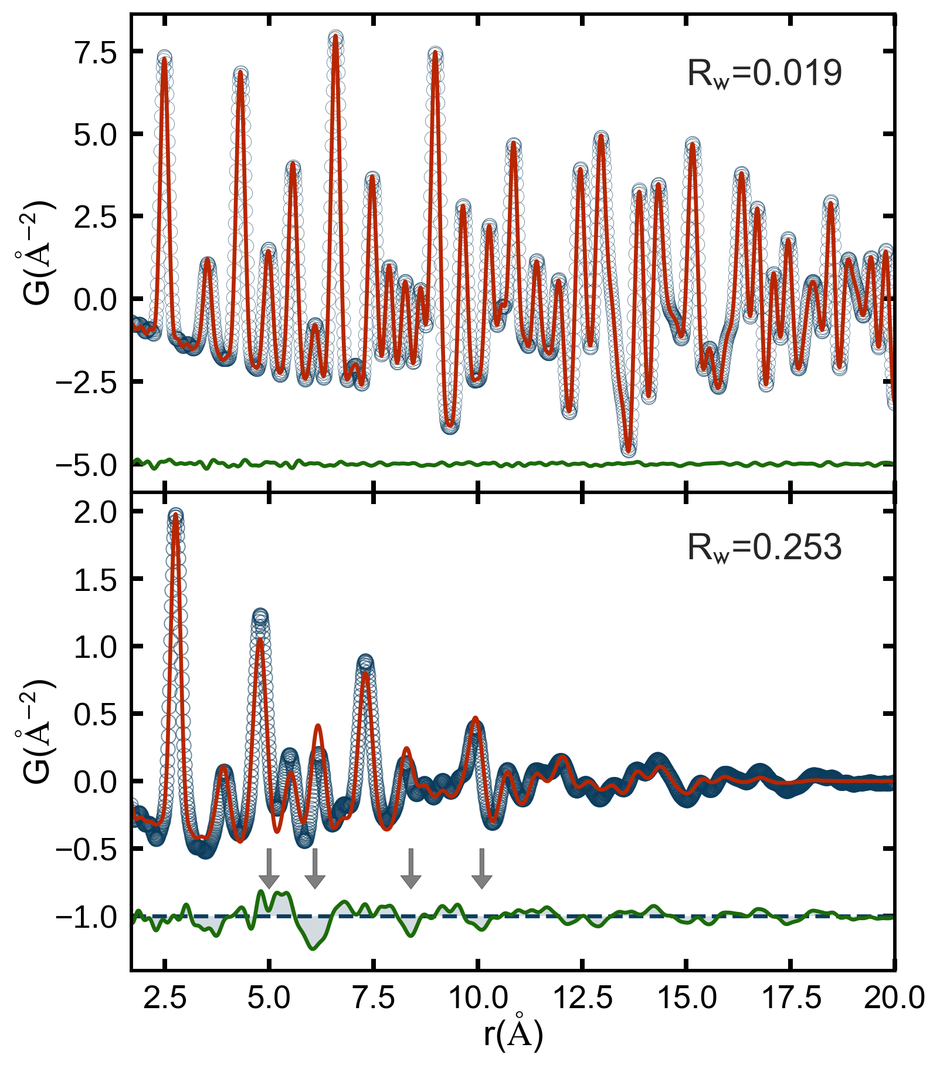
Banerjee, SJLB, et al. “Improved models for
metallic nanoparticle cores from atomic pair distribution function (PDF) analysis”. In: J. Phys.
Chem. C 122.51 (2018), pp. 29498–29506. doi: 10.1021/acs.jpcc.8b05897.

Slide 10
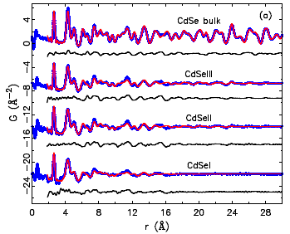
The Bathwater being thrown away
Excuses excuses excuses!
Can we do better?

Slide 11
Is there a baby in the bathwater?

Slide 12
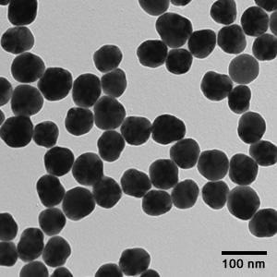
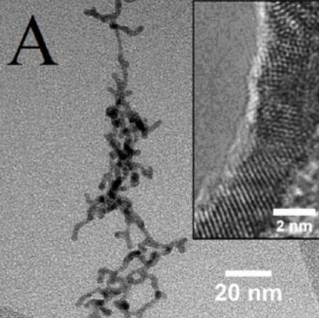
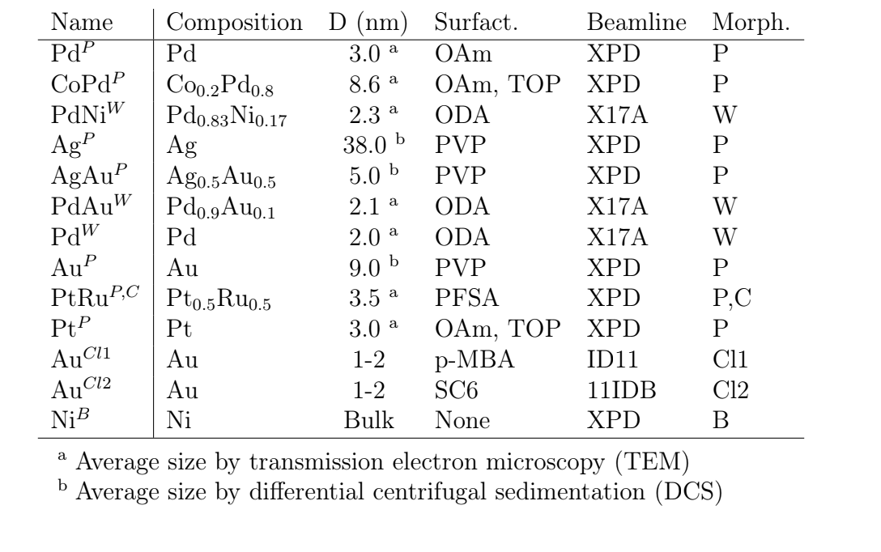
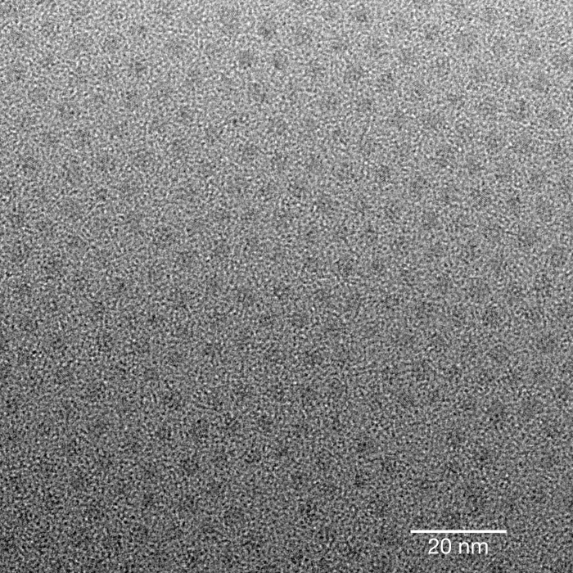
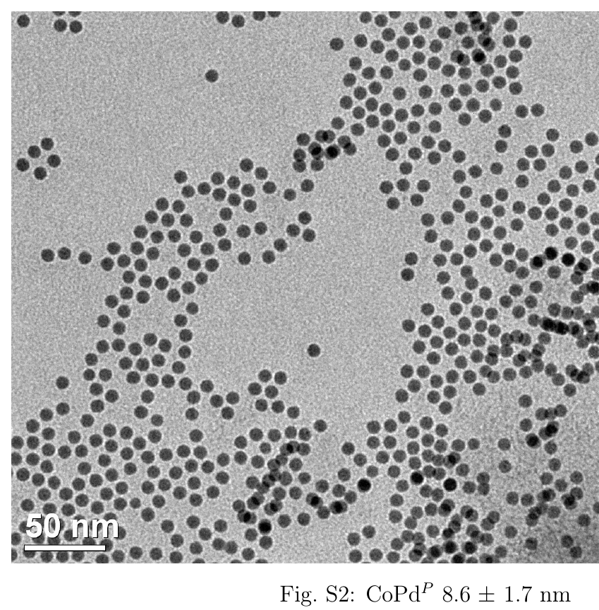

Slide 13
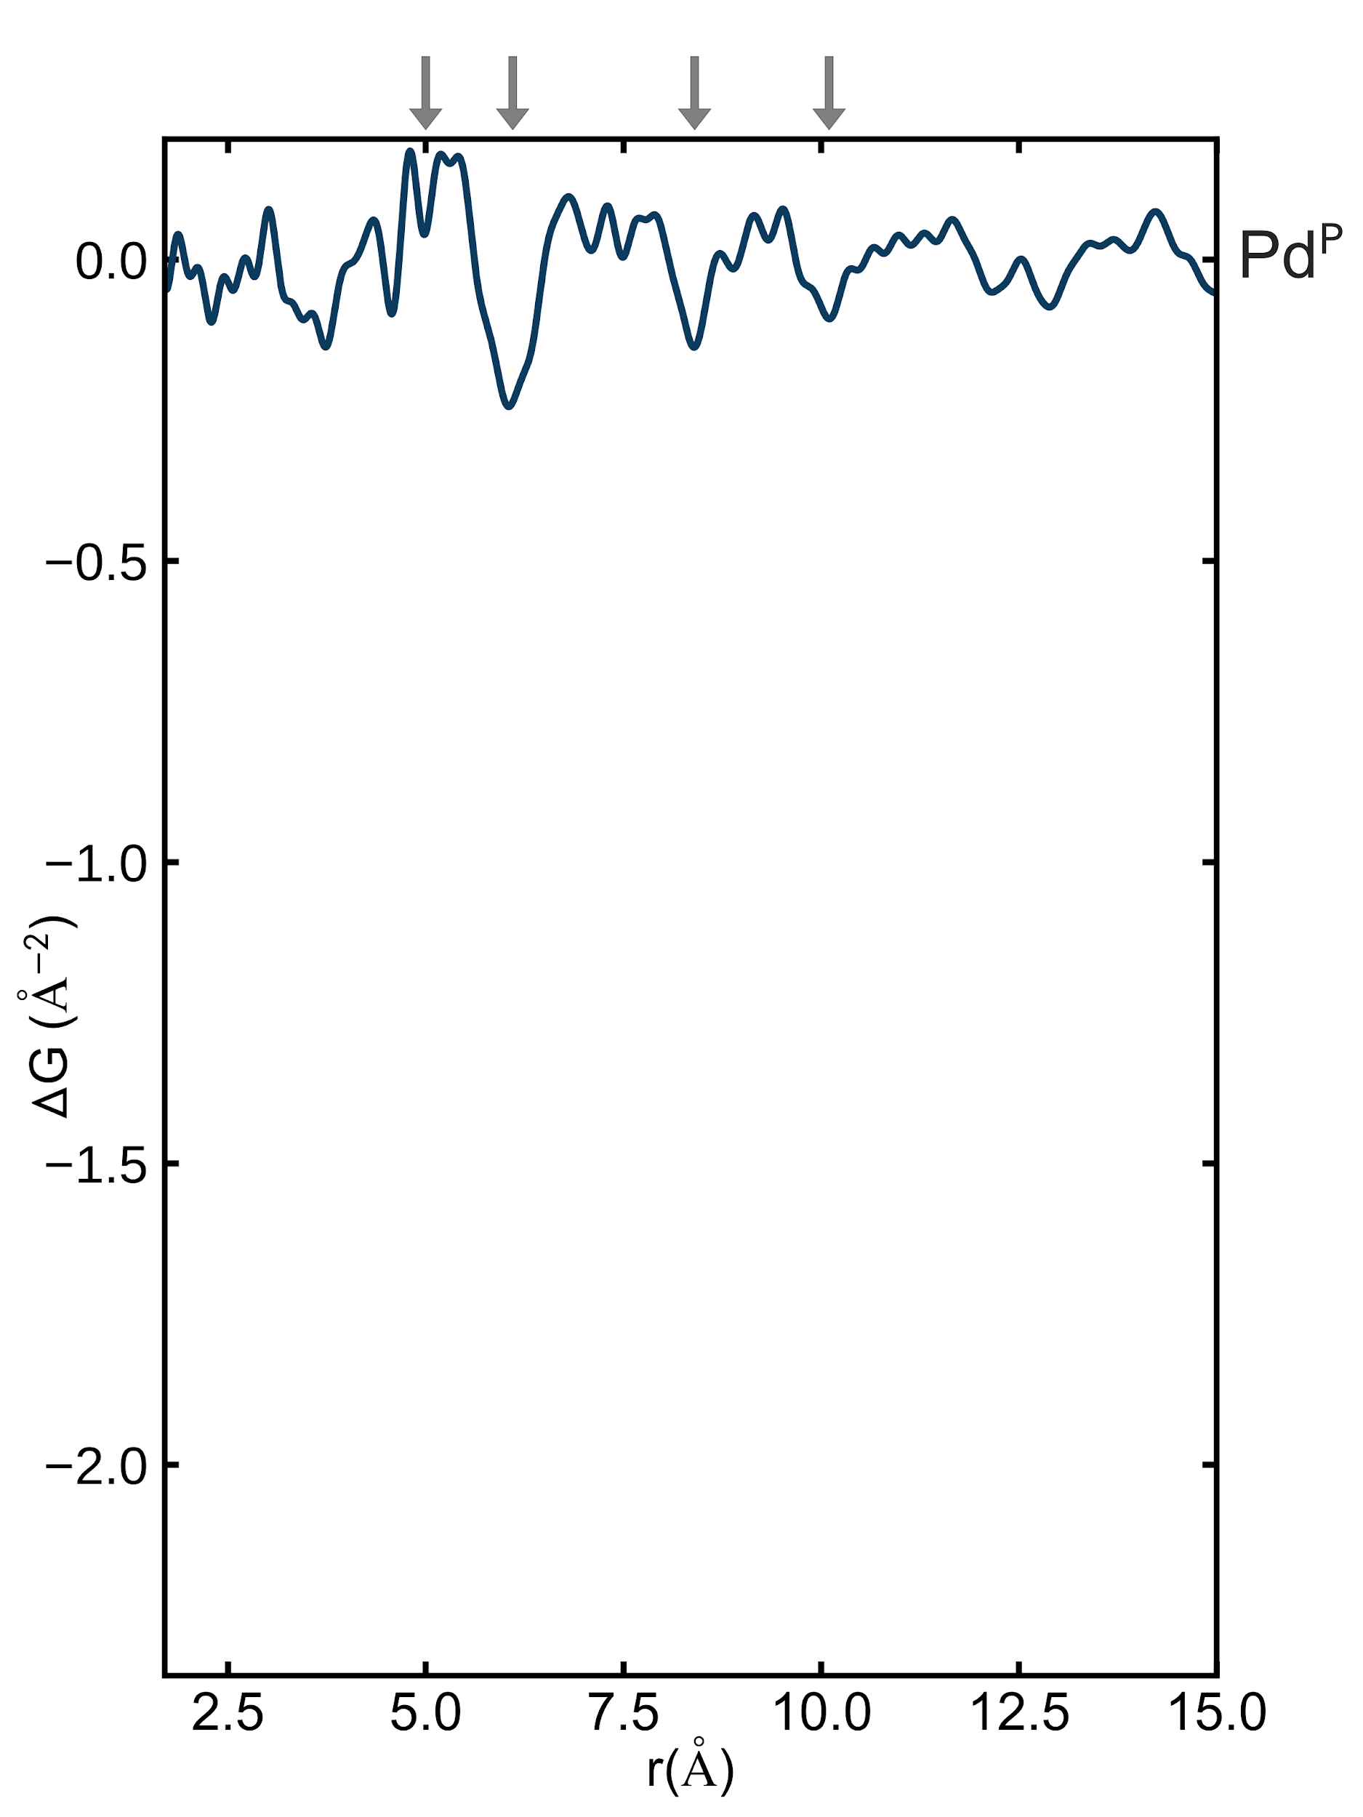
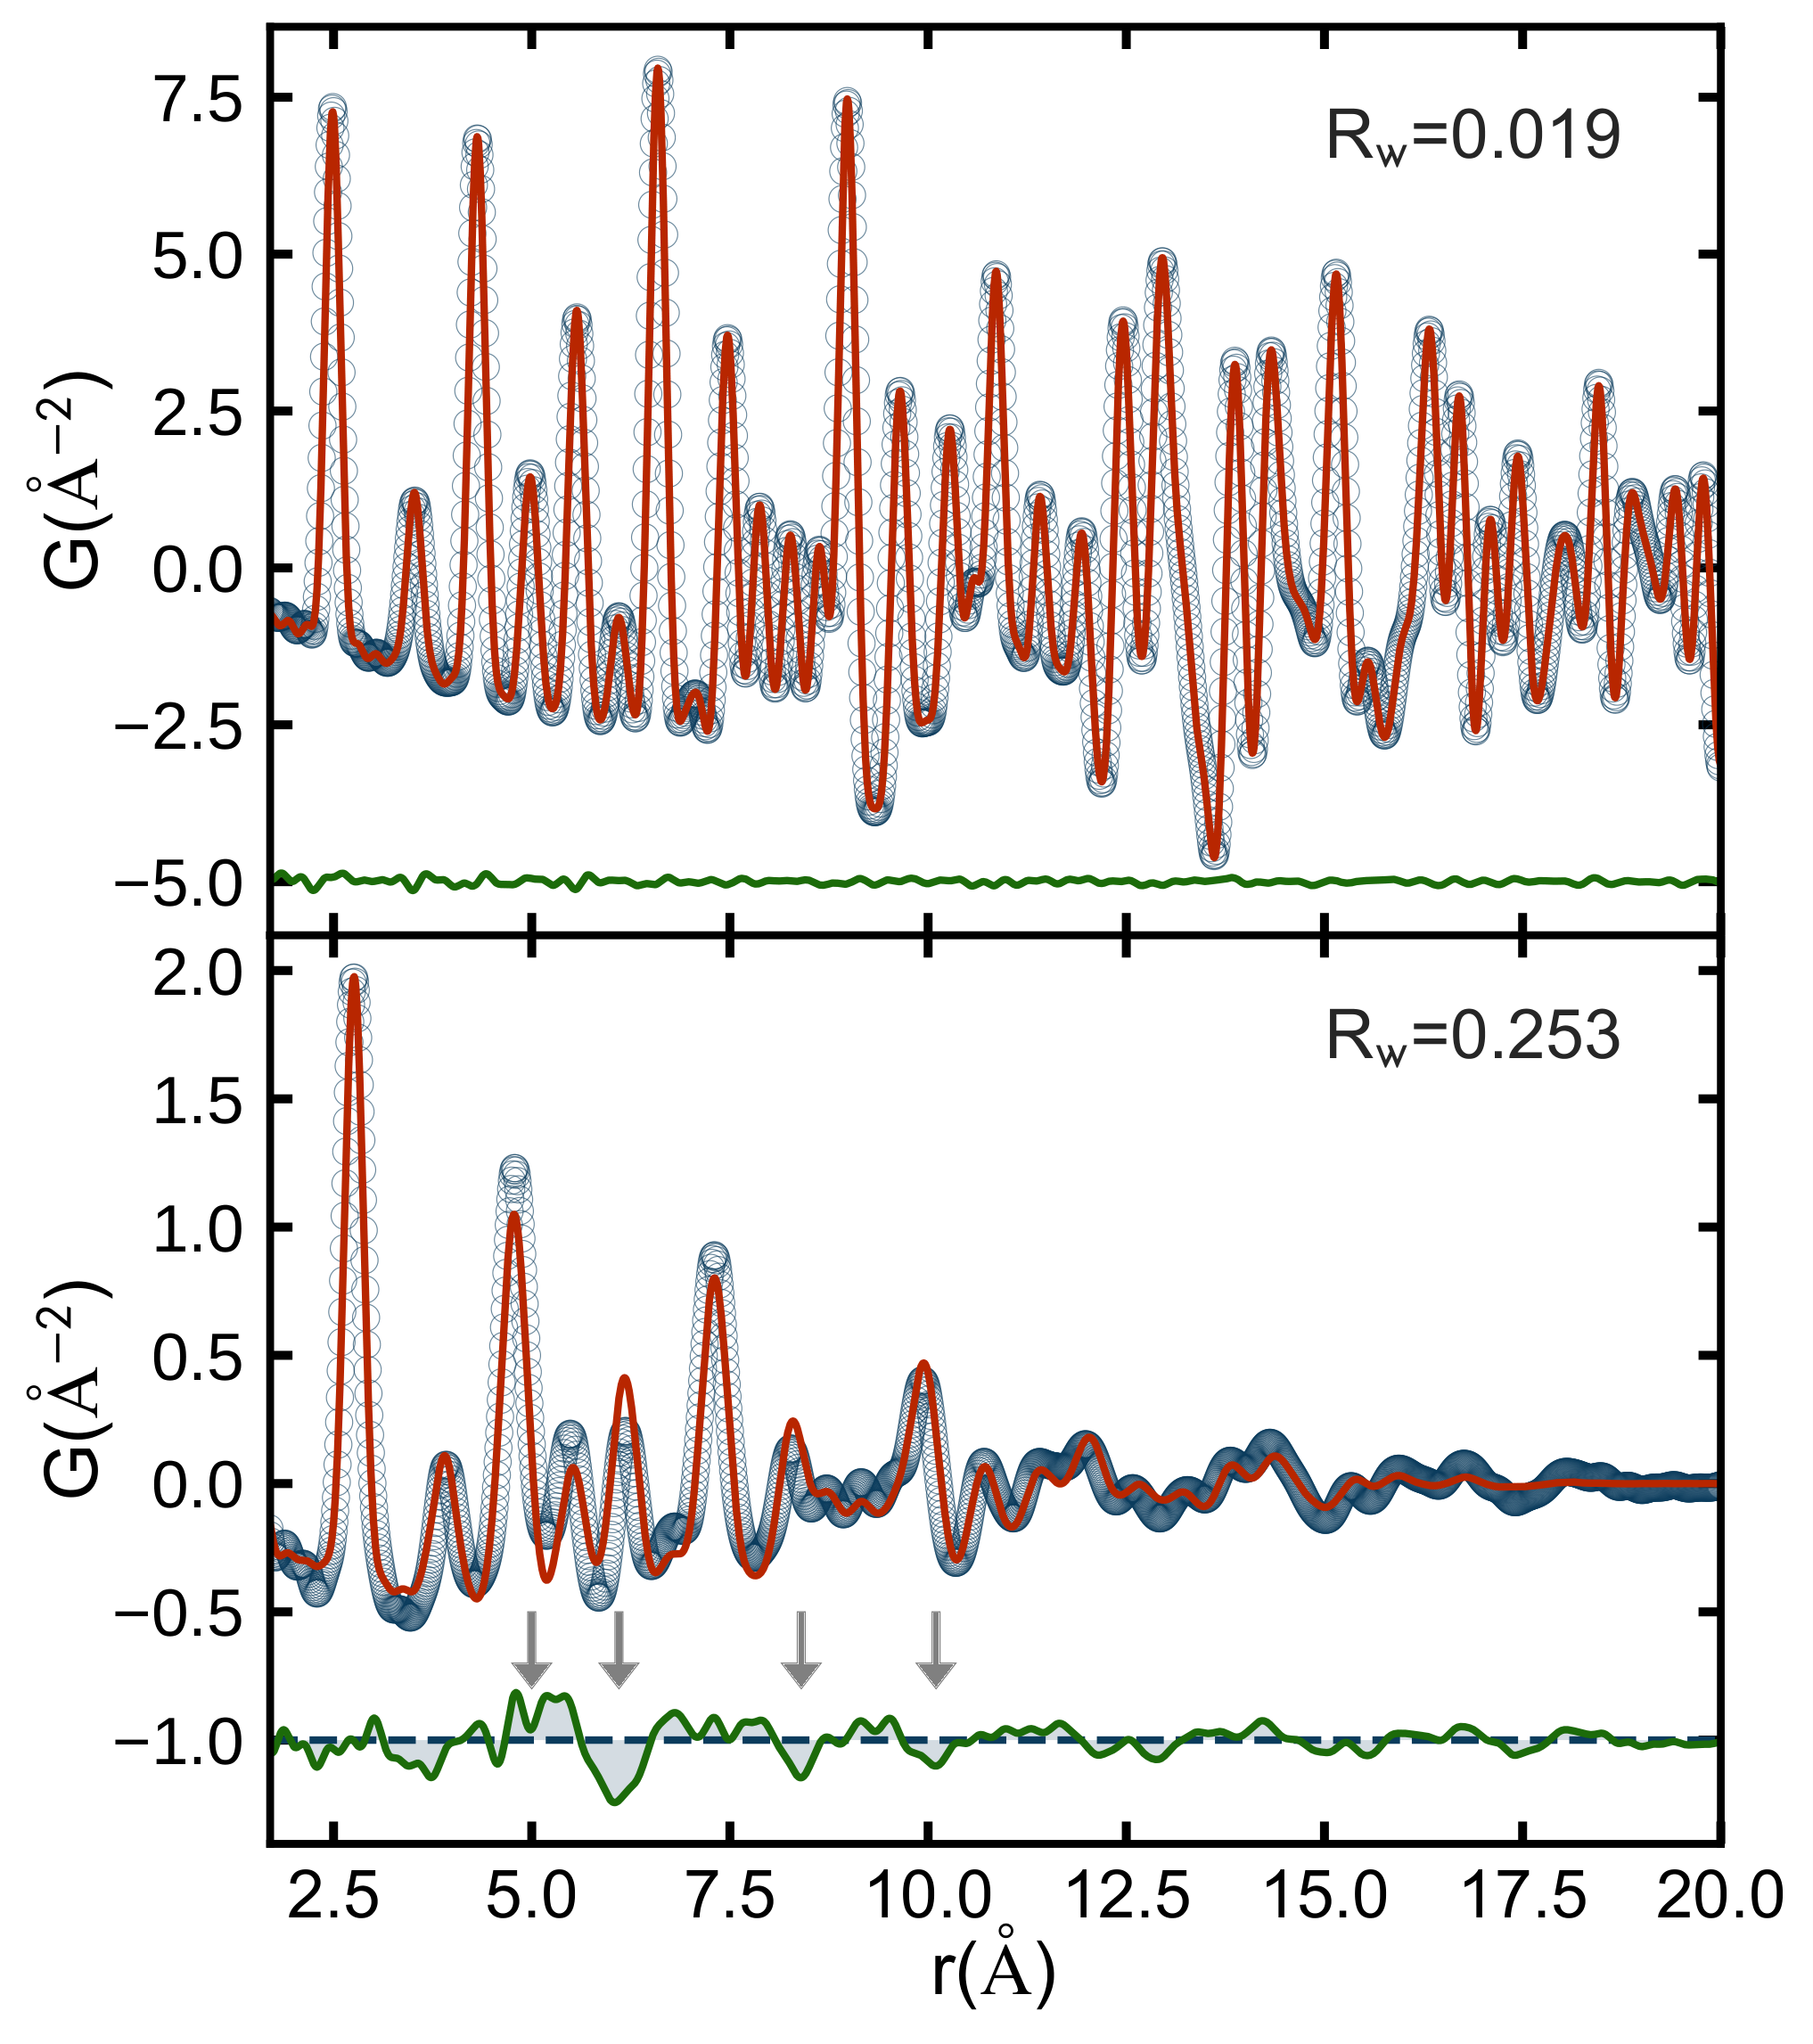
Residuals

Slide 14
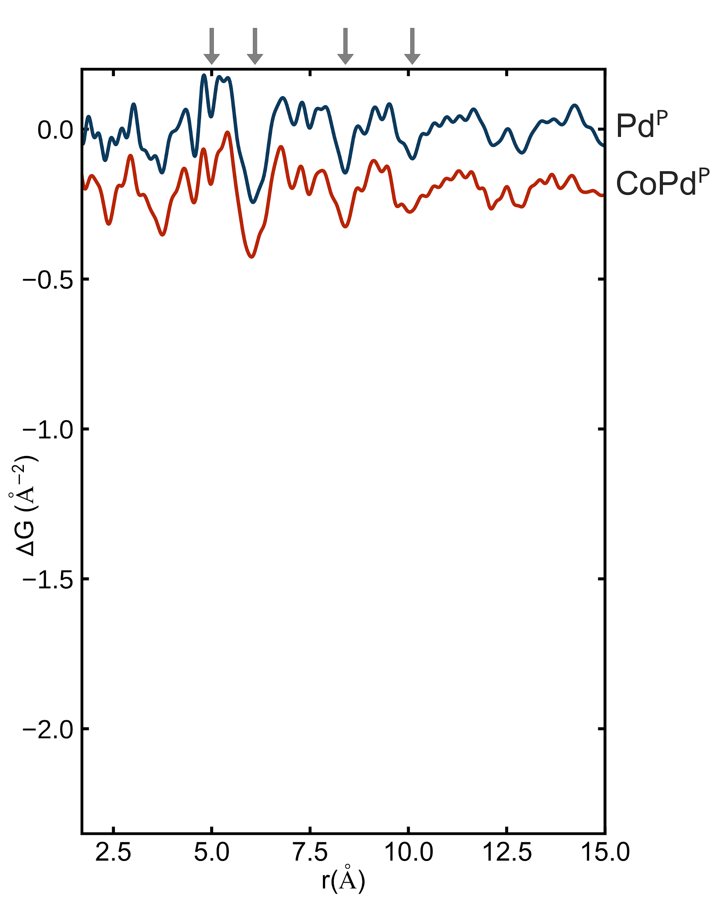
Residuals

Slide 15
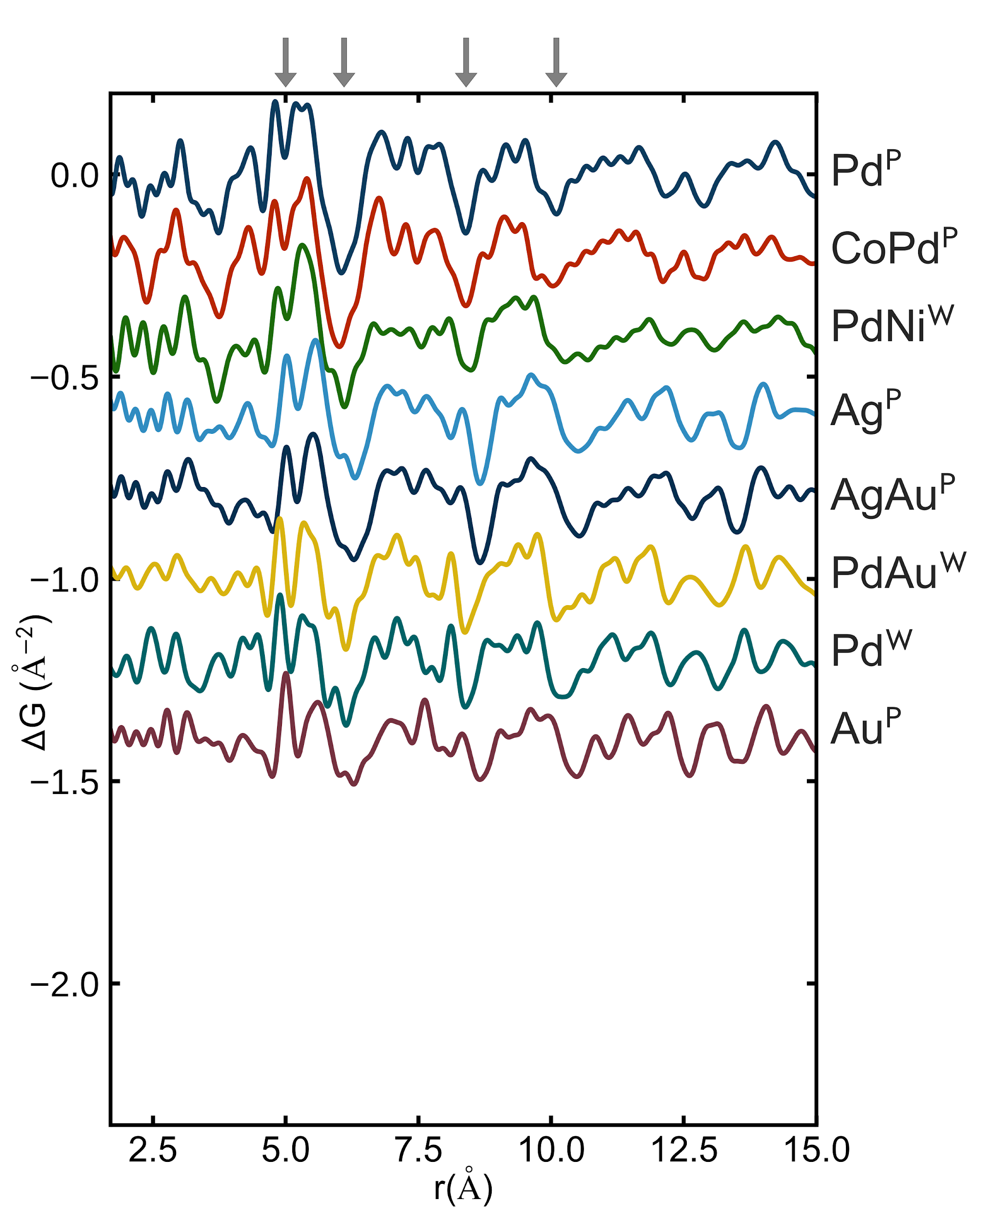
Residuals

Slide 16
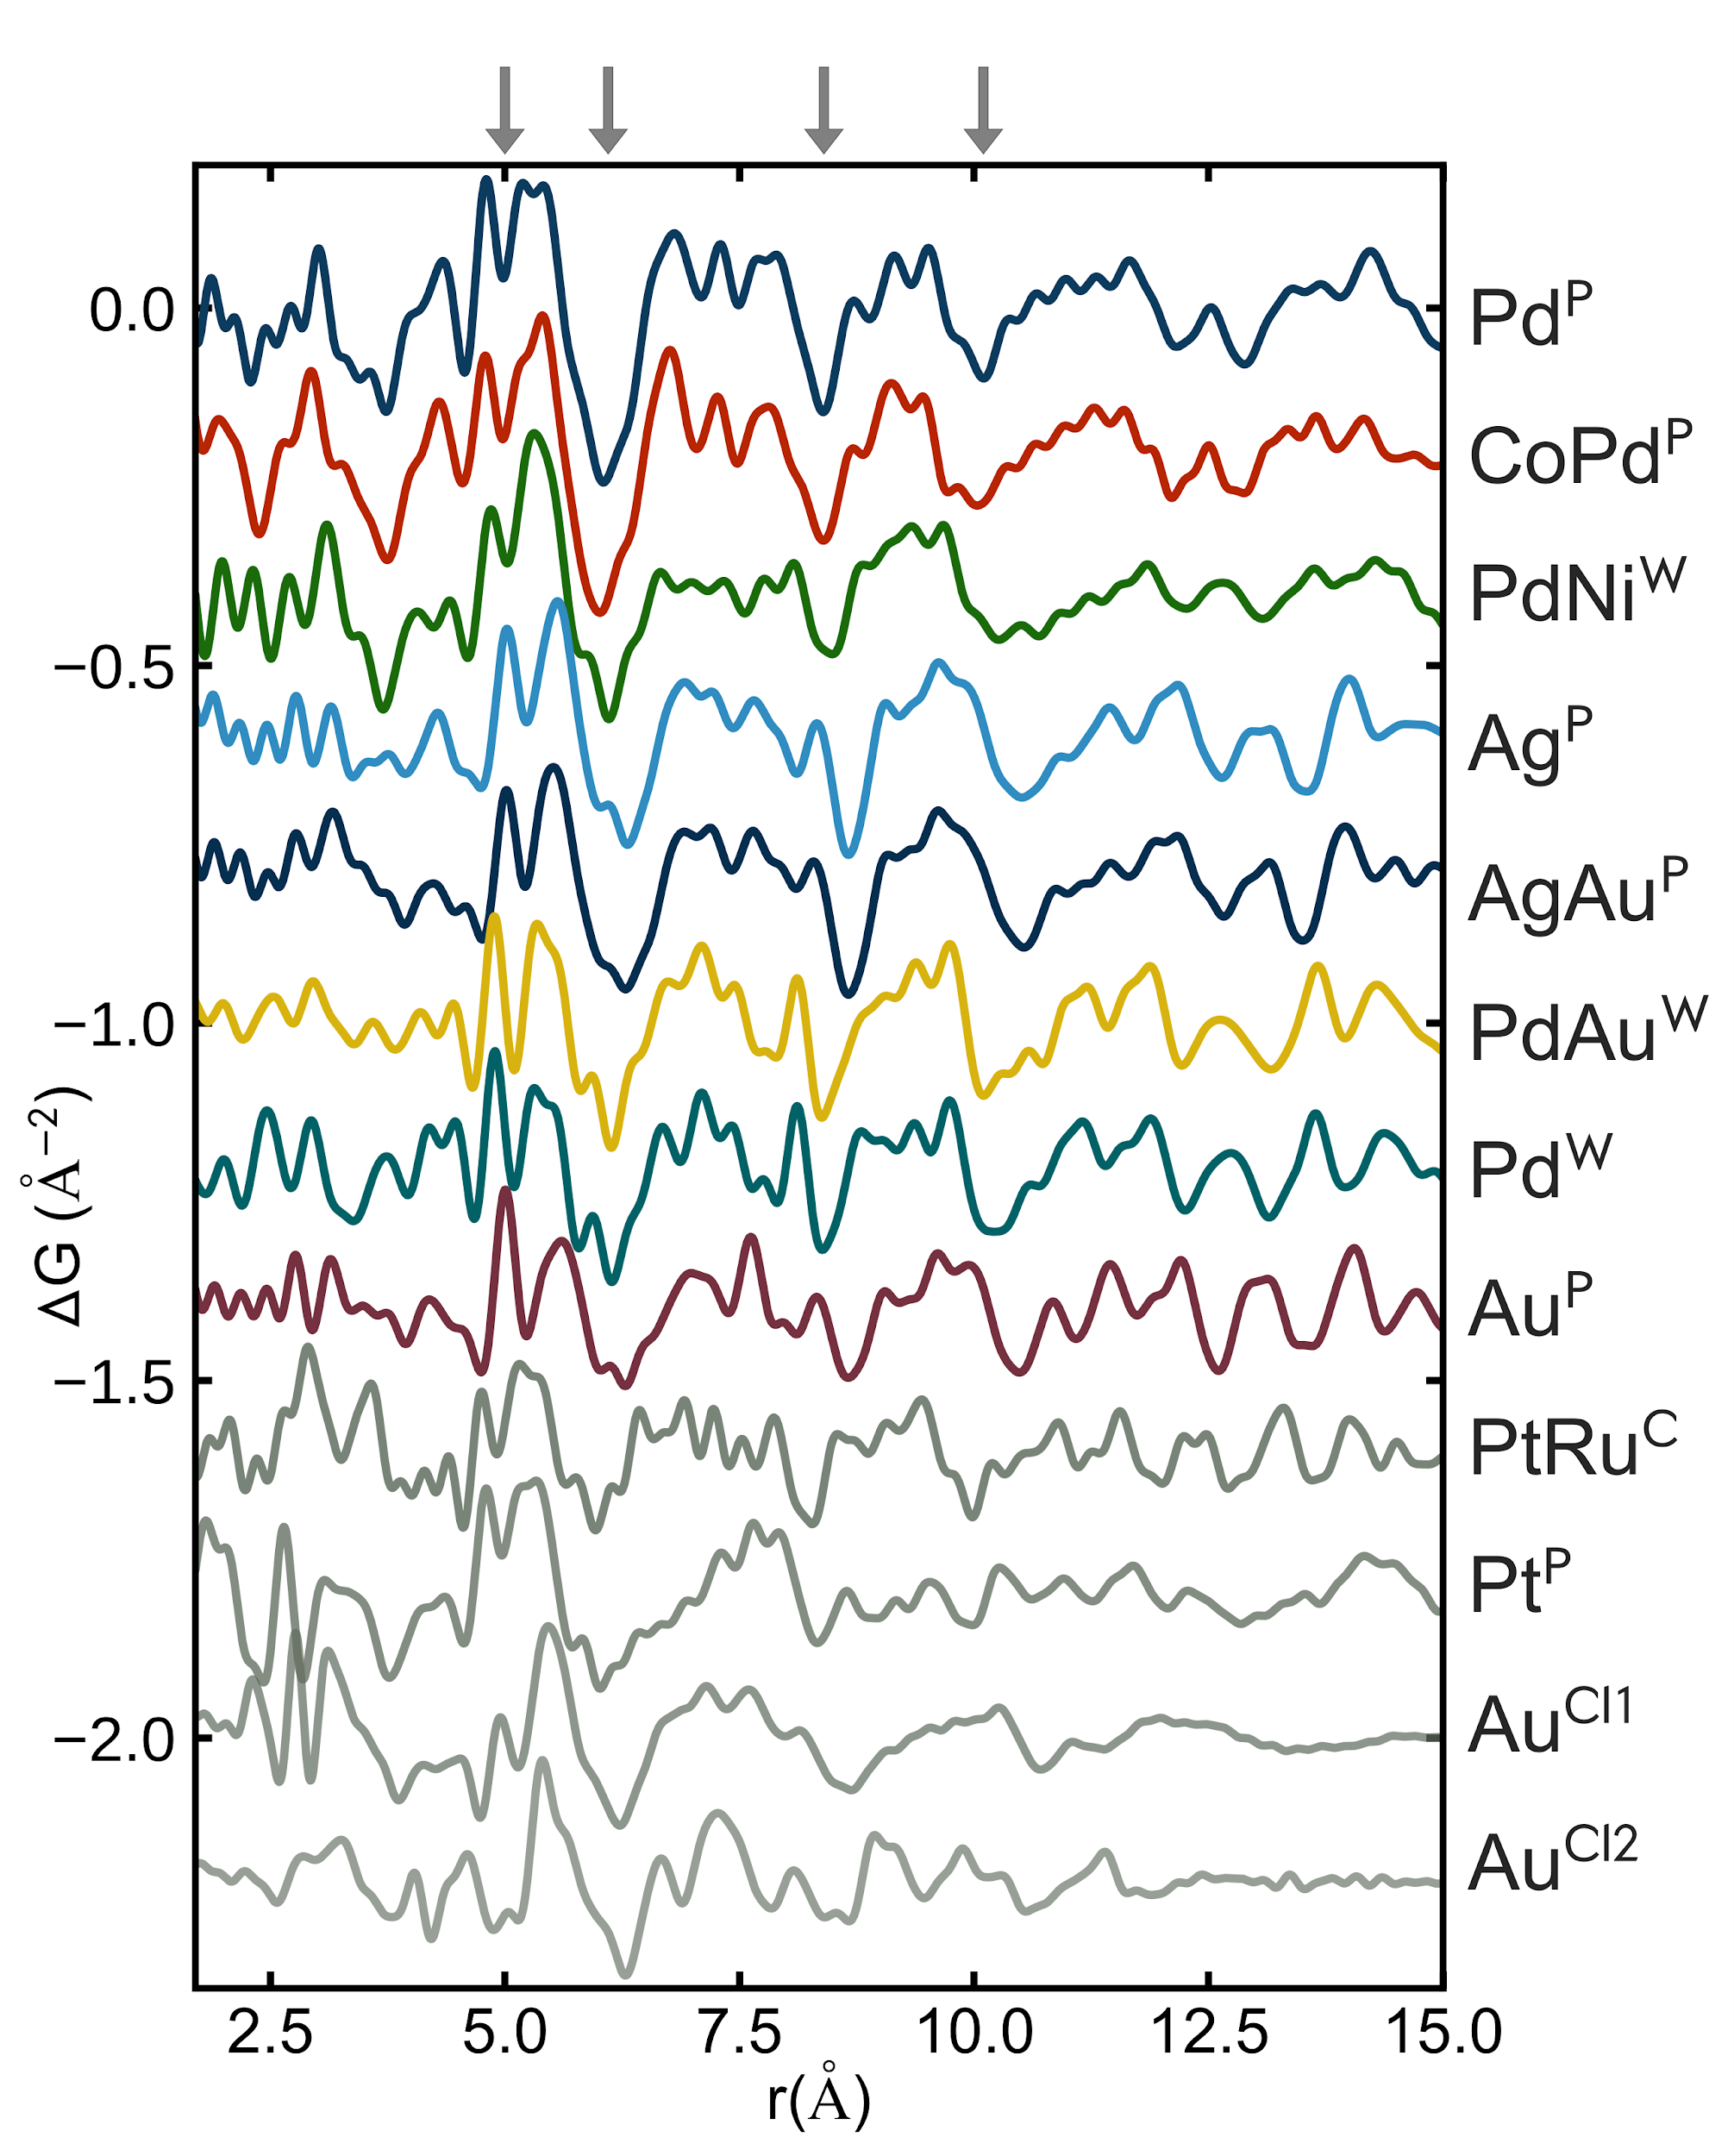
Residuals

Slide 17
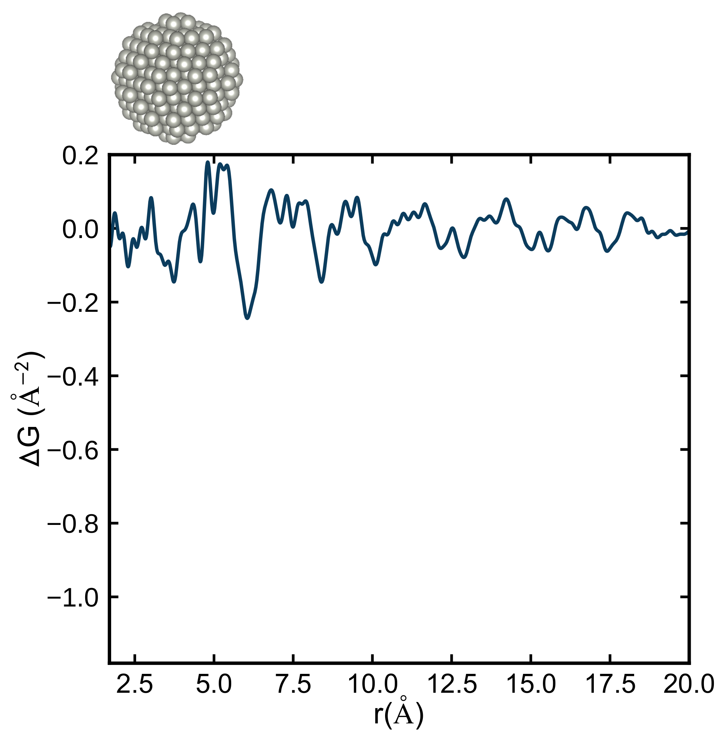
Testing discrete models

Slide 18
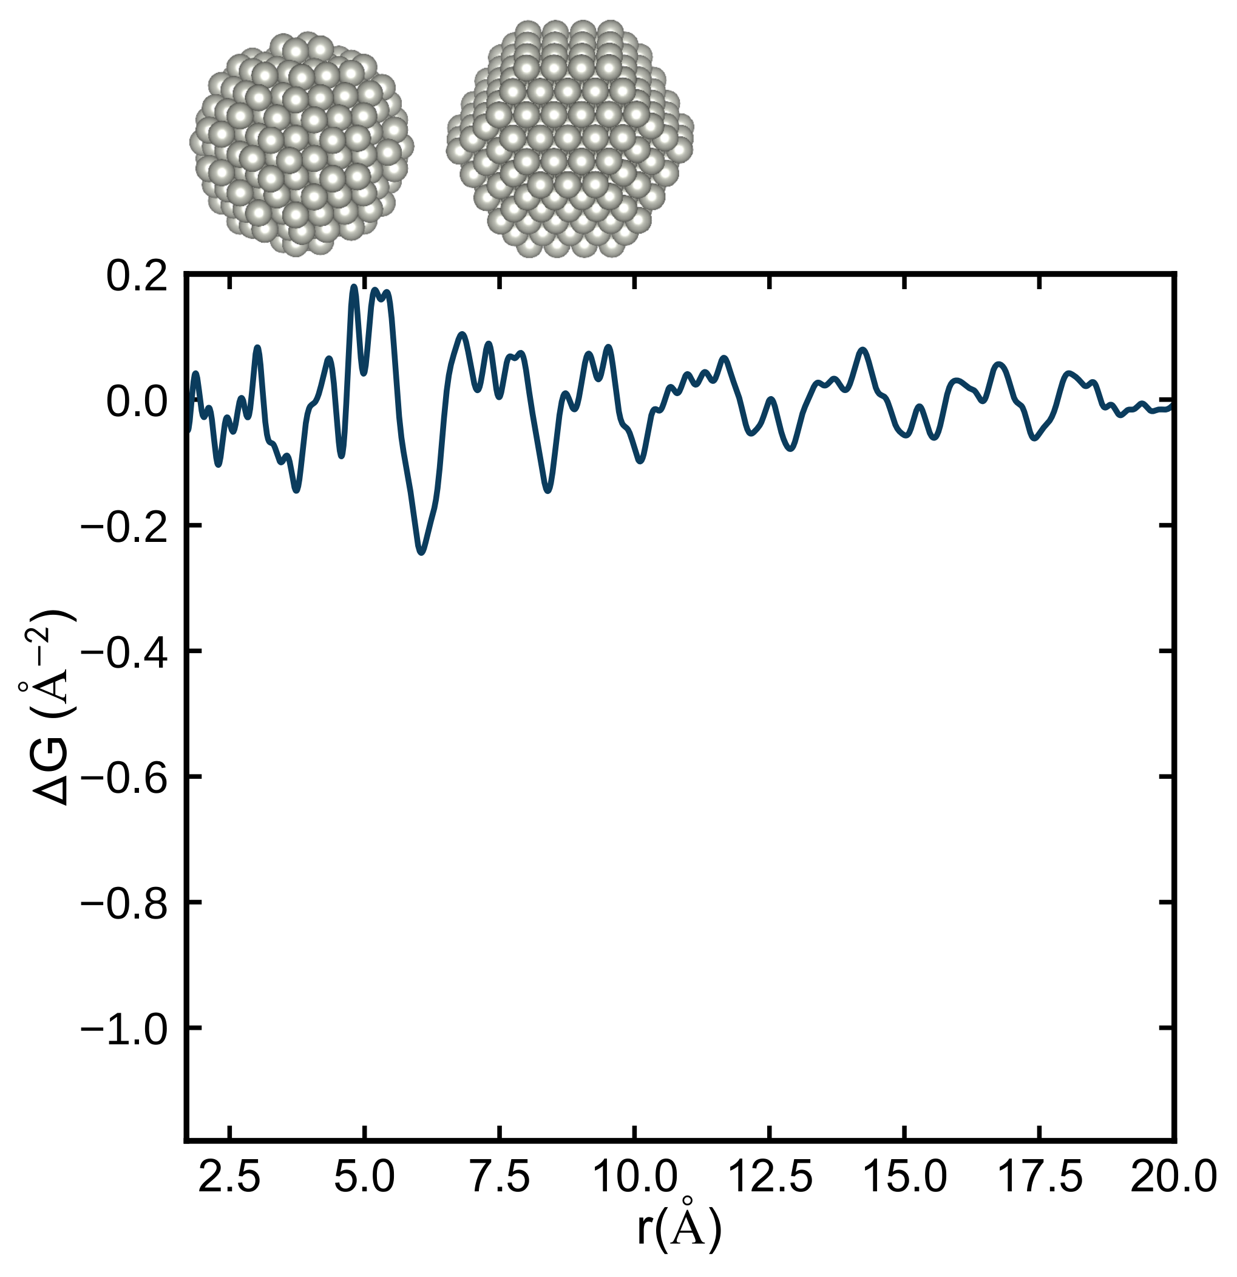
Testing discrete models

Slide 19
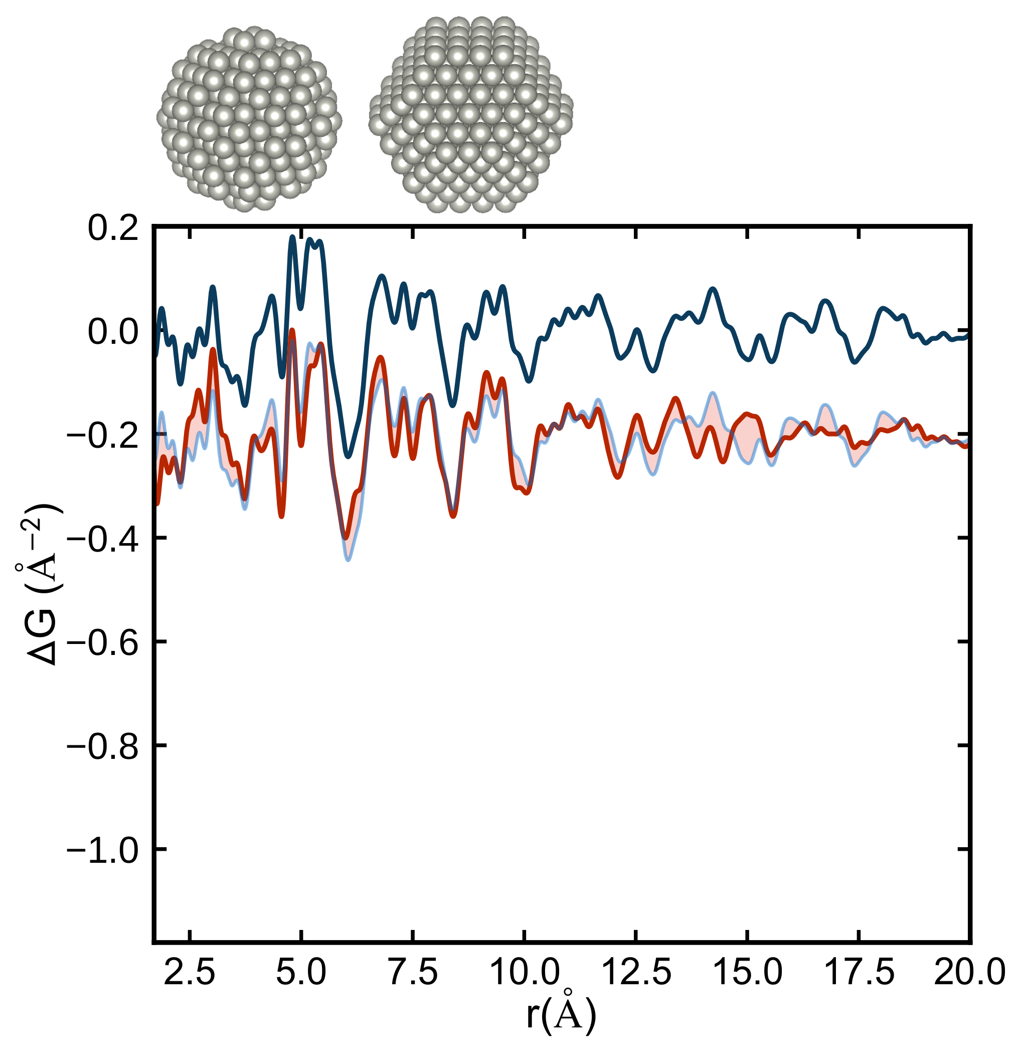
Testing discrete models

Slide 20
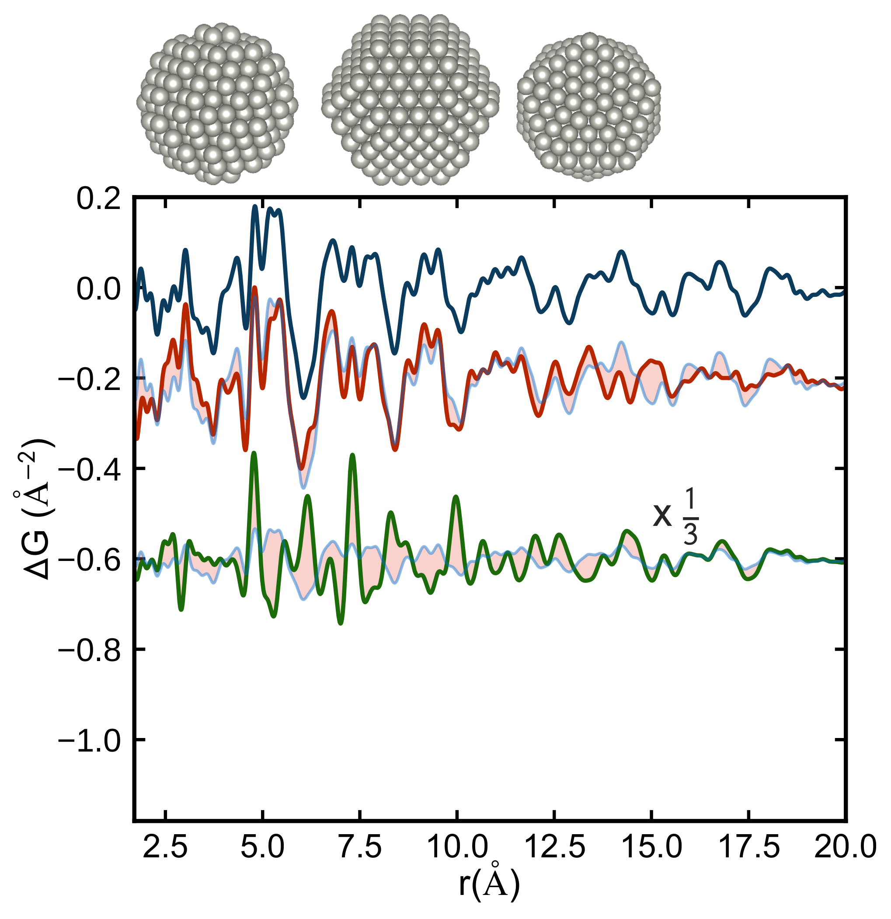
Testing discrete models

Slide 21
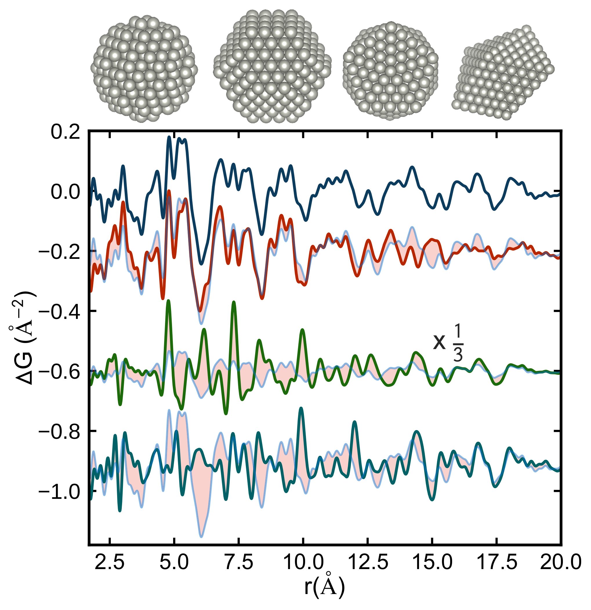
Testing discrete models
Banerjee, SJLB, et al. Improved models for metallic nanoparticle cores from atomic pair distribution function (PDF) analysis”. In: J. Phys. Chem. C 122.51 (2018), pp. 29498–29506. doi: 10.1021/acs.jpcc.8b05897.

Slide 22
Automating cluster finding

Slide 23
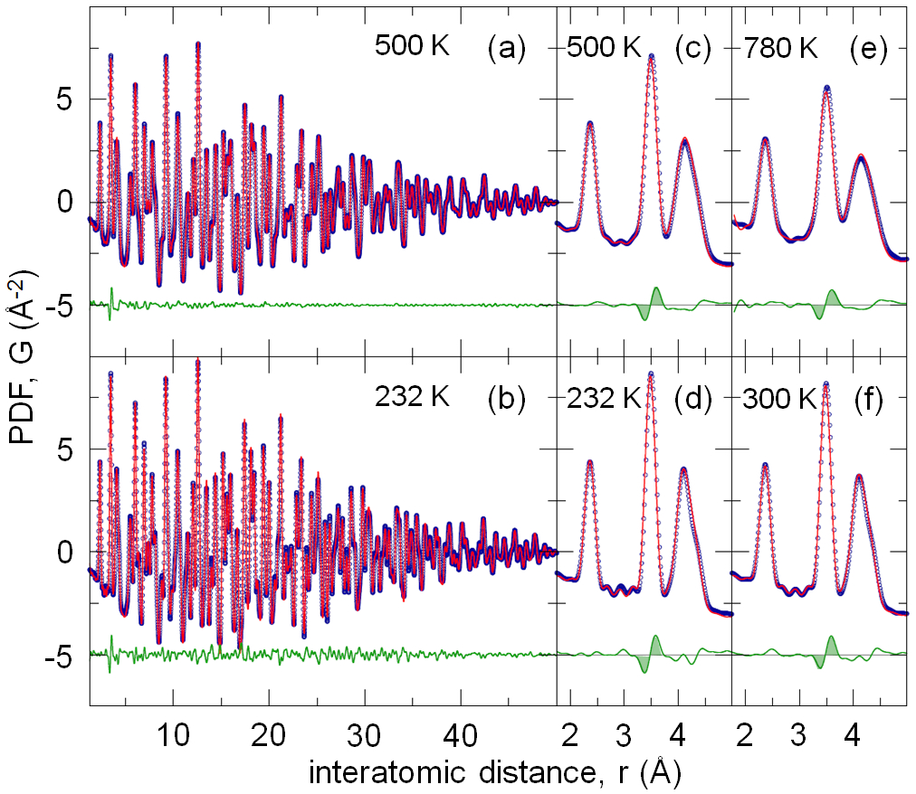
Standard approach
1 PDF
1 model
20 parameters
Vary the parameters until the model agrees as well as possible with the data.
Emphasis on parameter estimation, not on model selection
Challenge is finding the right model

Slide 24
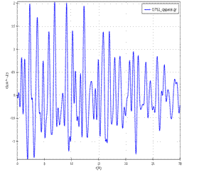
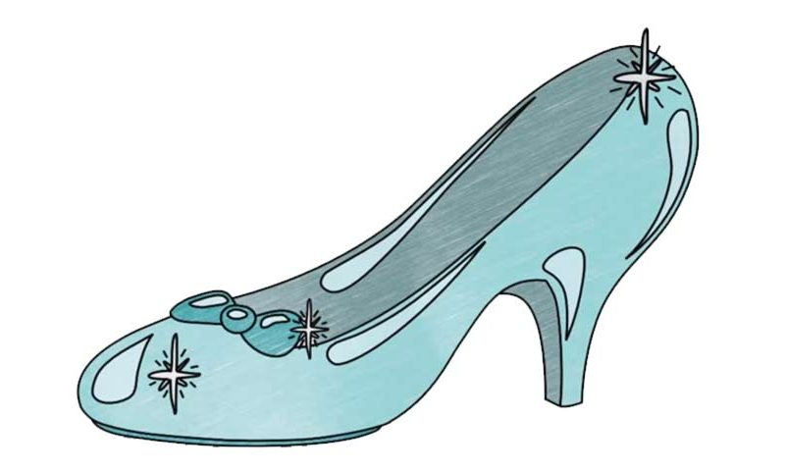
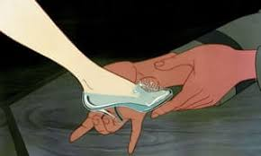
New approach:
Structure-Mining
1 PDF
many models
few parameters
Iterate over large numbers of models
Emphasis on model selection
Advantage: find multiple nearby models!
Challenge: structure must be in the structure-mine

Slide 25
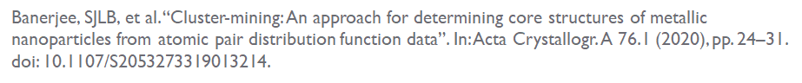
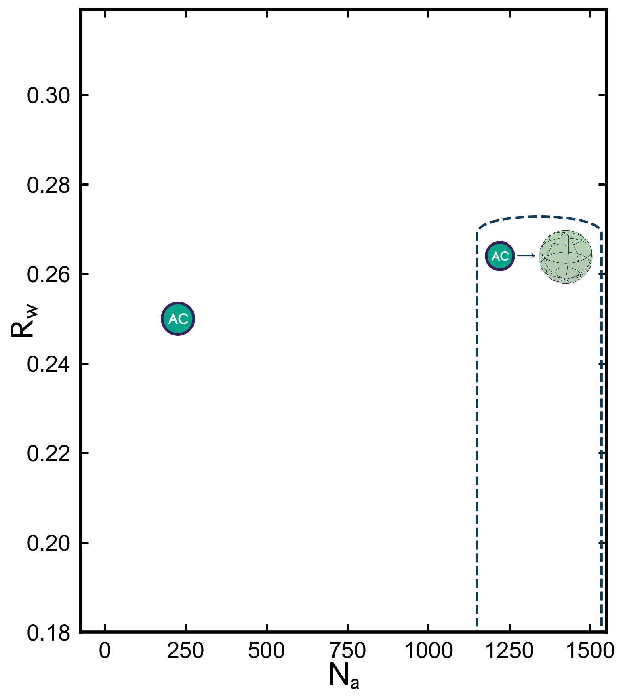
Notes:
Now we go to the mines. We’re gonna plot the Rw from all the structures we have in the mines. What if we make different cutouts from pristine fcc material?
What if we vary the number of atoms in these cutouts?

Slide 26
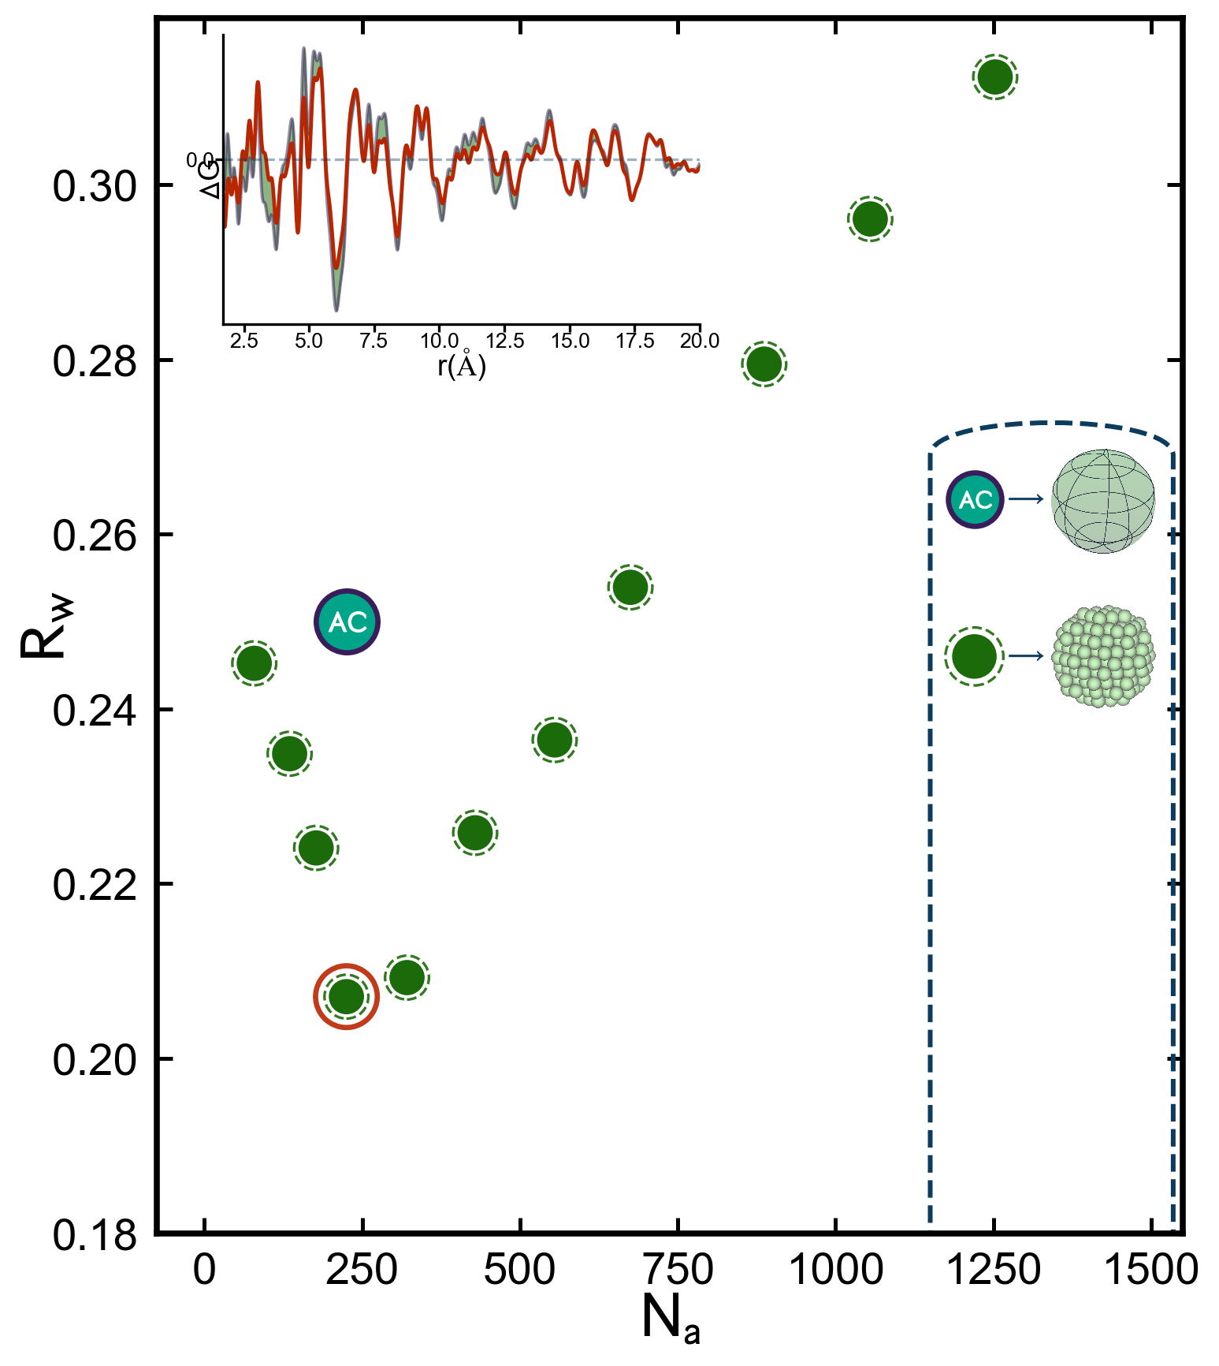

Slide 27
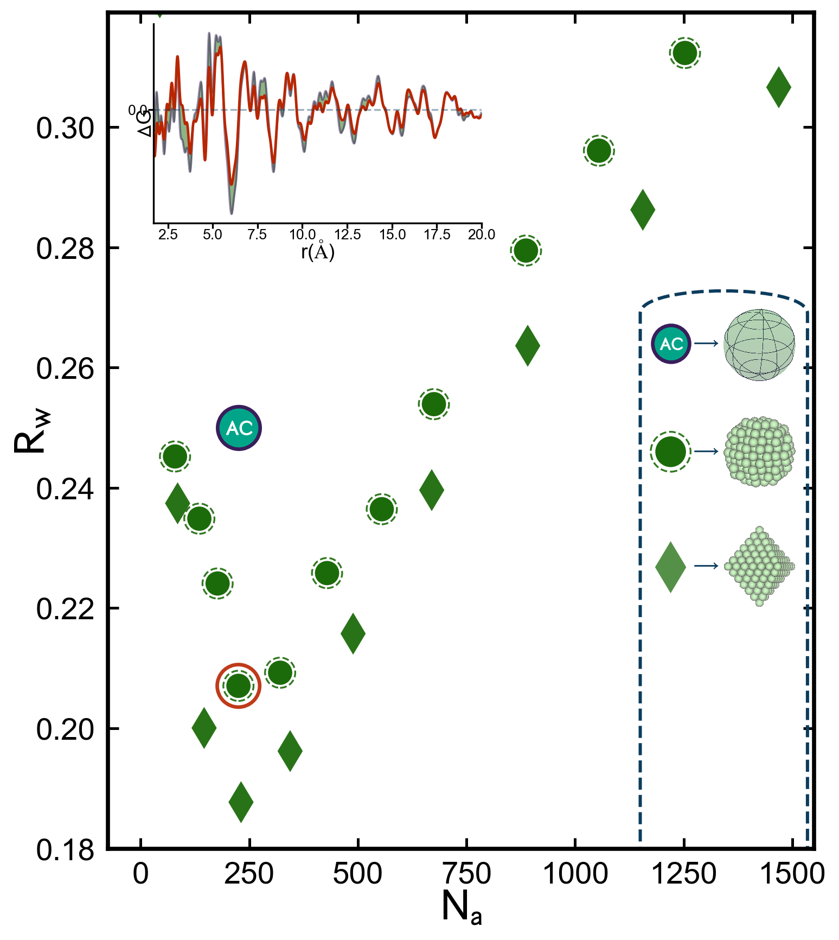

Slide 28
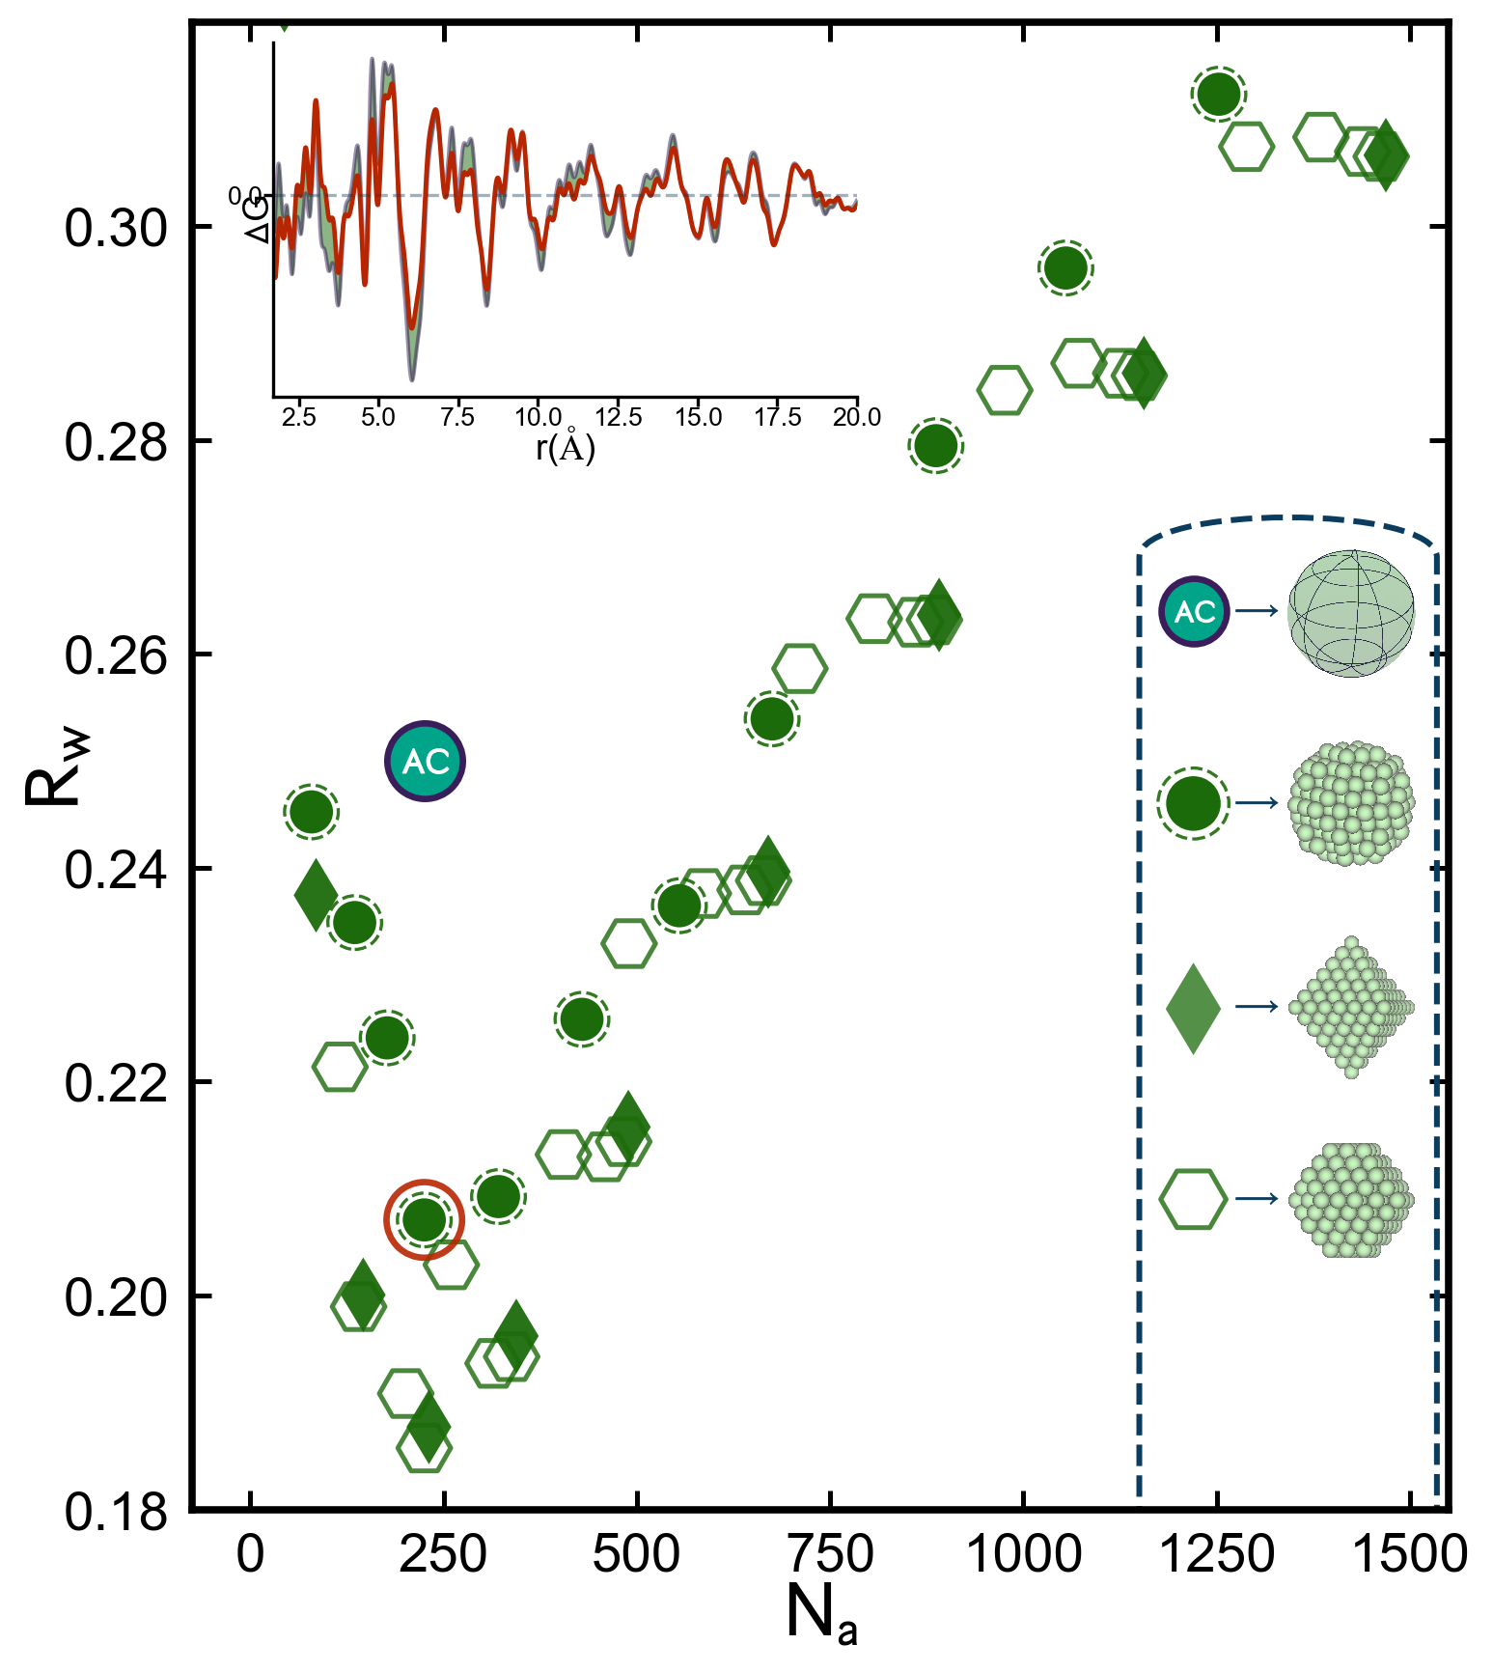

Slide 29
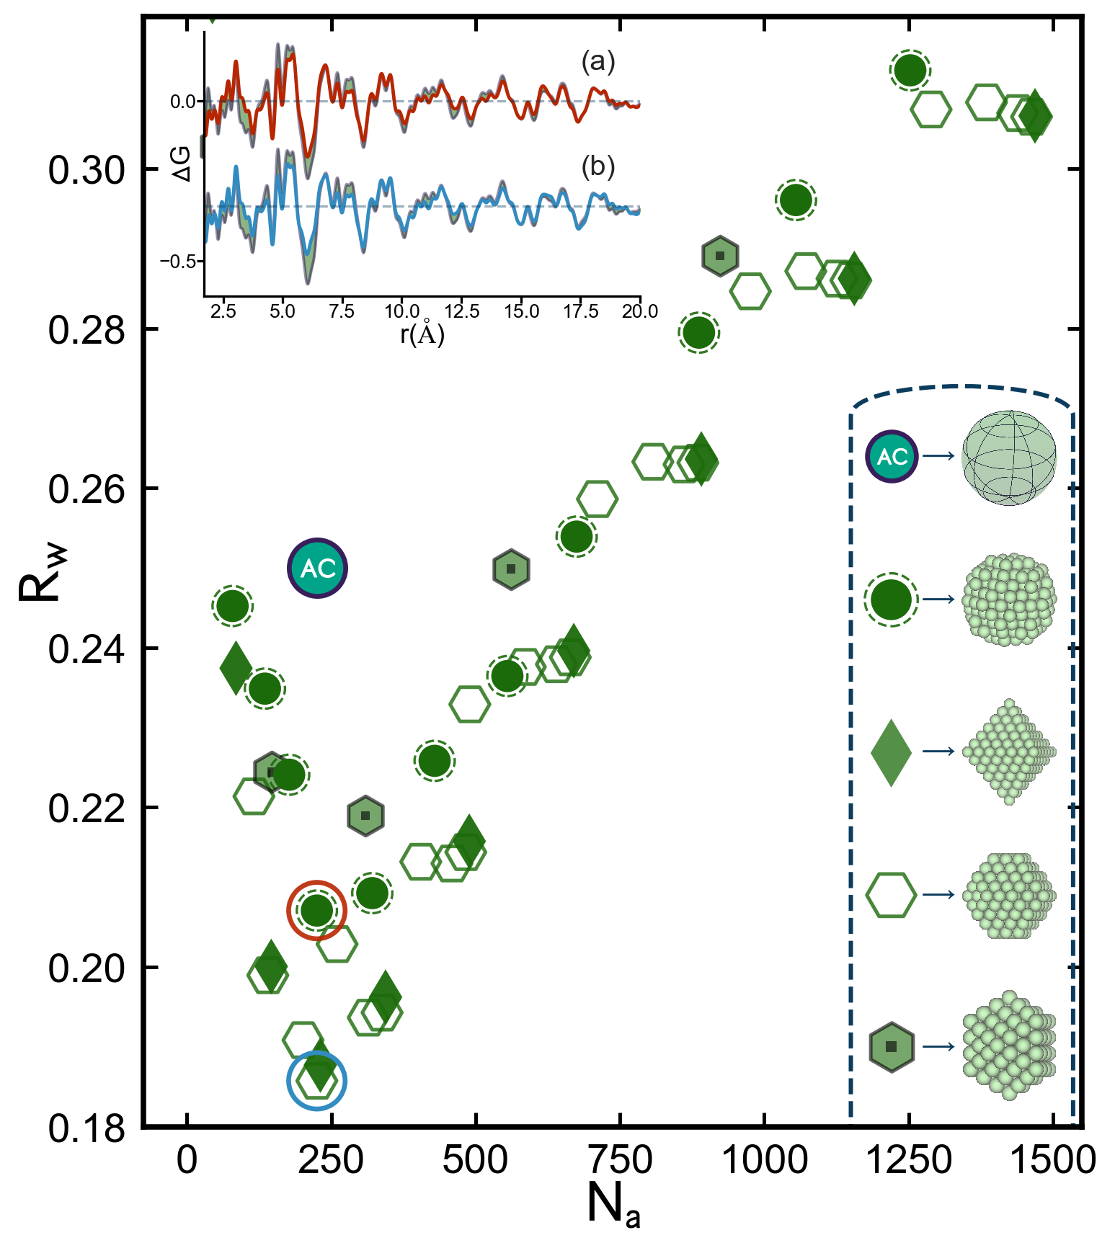

Slide 30
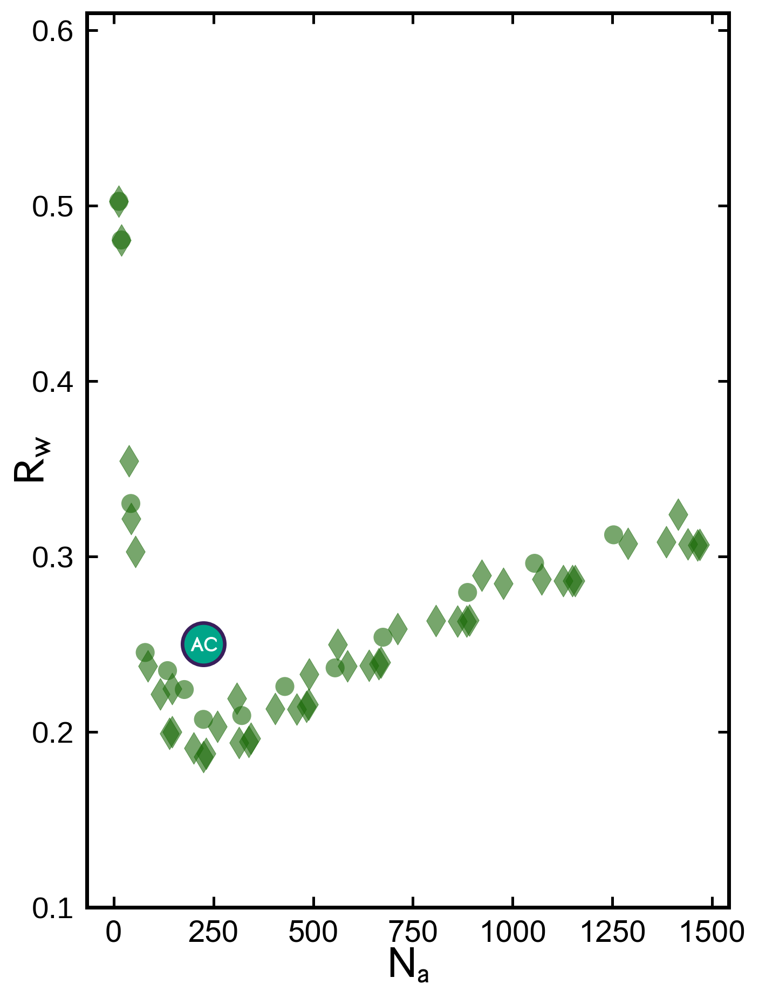
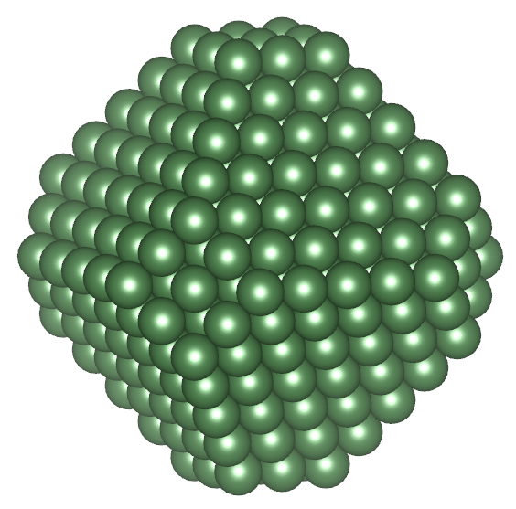
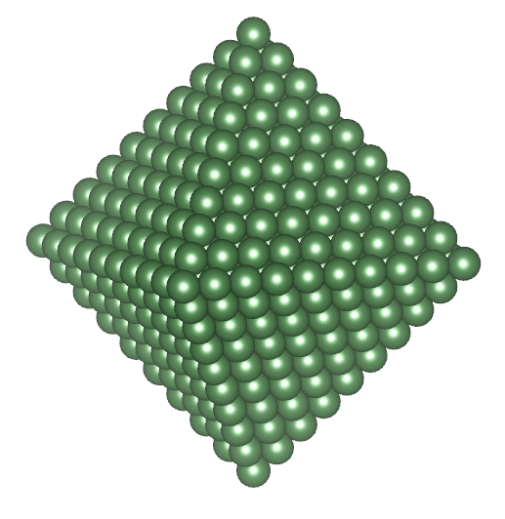
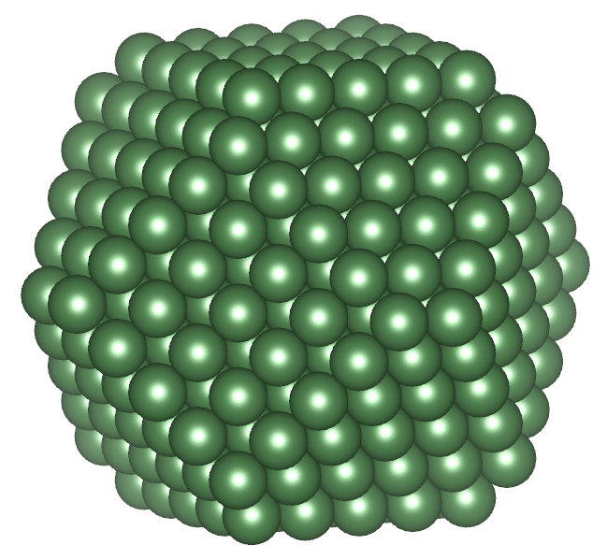
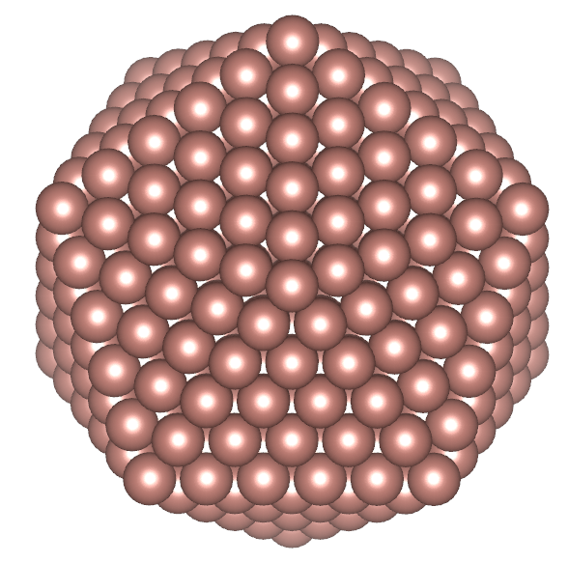
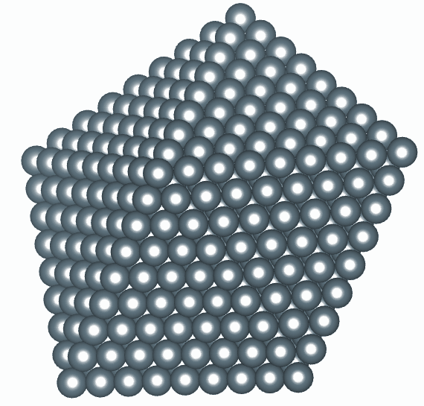
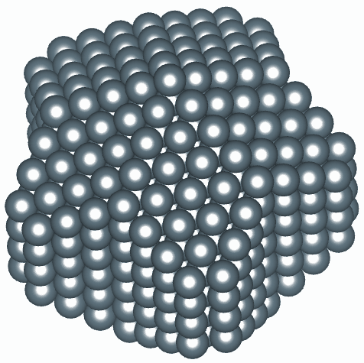
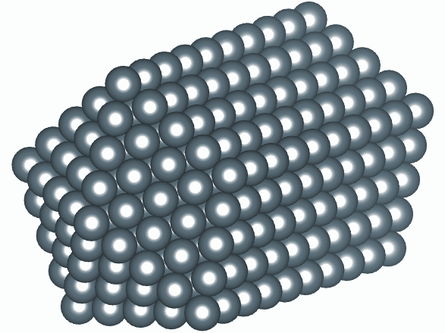

Notes:
Are there other motifs.

Slide 31


Slide 32

Notes:
Talk about families.
Add Pd NP label (3 nm)

Slide 33
Challenges/opportunities
Building models
Smart searches
Handling degeneracy/breaking degeneracy with complementary information

Slide 34

Structure-mining: An automated screening of large numbers of candidate structures to the atomic pair distribution function (PDF)
Long Yang, Pavol Juhas, Maxwell W. Terban, Simon J. L. Billinge

Slide 35


Introduction
R_{w} sorted structure-mining result
Crystal structural database
Materials Project Database
Crystallography Open Database
PDF auto-refinement
Example result of BaTiO3 nanoparticle heuristic- 1
DiffPy-CMI

Slide 36

Heuristic-4 (*-*-Si-O)
Structure-mining found the same model as in prior work, MPD No. 1003 (NaFeSi₂O₆) and COD No. 2983 (NaFeSi₂O₆), s.g.: C 2/c.
It also returns some structures with space group C 2, such as MPD No. 998 (Na_{0.83}FeSi₂O₆), which may be viewed as a very similar structure but with a lowered symmetry and deficient atoms at some sites
It also returns some structures substituting at Na or Fe sites by other elements. For example, MPD No. 1021 (NaGaSi₂O₆).

Slide 37

This new approach to modeling opens the door for Machine Learning/Deep learning
I don’t know an person who can look at a PDF and tell the s.g. (except perhaps if it is an fcc material or something)
Question:
Can we train a Machine Learning model to recognize it?
Answer:
Yes!
Chia-Hao Liu, Yunzhe Tao, Daniel J. Hsu, Qiang Du, and Billinge, Simon J. L. , Acta Crystallogr. A 75 (2019), pp. 633–643.
doi: 10.1107/S2053273319005606.

Slide 38
Details
Work of Yunzhe Tao and Chia-Hao Liu
PDF itself is the input feature vector
101,802 structures in 45 space-groups
Train on 80% of data, 20% retained for testing

Slide 39
Space Groups from PDFs
First try, Logistic Regression
Second try, Convolution Neural Net
Classification ratio’s are for finding the right s.g. in the top 6

Slide 40

Confusion Matrix
Rows: true label
Columns: predicted label

Slide 41

To the cloud!!!!! Pdfitc.org

Slide 42


Slide 43


Slide 44
Sensitivity: Dilute systems

Slide 45



Quantifying amorphous API contents in the presence of crystalline material
Collaboration with Matthew Johnson, Senior Investigator, GlaxoSmithKline, thanks for help from Marco di Michiel
Data ID15, ESRF
Maxwell W. Terban, Matthew Johnson, Marco DiMichiel and Simon J. L. Billinge, Nanoscale 7, 5480-5487 (2015).

Slide 46

Characterizing nanoparticles of APIs in suspension
Samples were API particles of various sizes and in various concentrations in aqueous suspension
These are drugs for nebulizer applications
The goal was to characterize the structure and nanoparticle size in the different suspensions.

Slide 47


Characterizing nanoparticles of APIs in suspension
Green: PDF of the crystalline control sample
Blue: PDF of the aqueous solvent
Reproducibility!
High-r region from the crystalline control and sediment from a high concentration suspension

Slide 48


Characterizing nanoparticles of APIs in suspension
Green: difference PDF (dPDF => solvent subtracted) from a suspension of 5wt% API in aqueous solvent
Blue: PDF of the crystalline API
Sensitivity!
Blue: 0.25wt% API
Green: 0.66wt% API
Red: 5% API
Can see nanocrystalline API even at the 0.25wt% level
Maxwell W. Terban, Matthew Johnson, Marco DiMichiel and Simon J. L. Billinge, Nanoscale 7, 5480-5487 (2015).

Slide 49


Applications: Molecular Precursors of Gold Nanoparticles
a
b
a
b
c
c
PDF used to investigate non-crystallized precursors in gold nanoparticle synthesis. Novel modeling of bond lengths and angles verifies planar 8-member ring structure. Collaboration with David Cliffel, Vanderbilt
C. A. Simpson, SJLB et al., Inorg. Chem. 49, 10858 - 10866 (2010)

Slide 50

Watching nanoparticle synthesis in-situ
We can see precursor species in solution
We can measure Nanoparticle structural parameters
High energy x-rays can penetrate relatively thick walled vessels
=> Let’s do in-situ studies of synthesis
Rich collaboration with the group of Bo Iversen (Aarhus)
Image credit Christoffer Tyrsted

Slide 51


It works!
J. Am. Chem. Soc. 134, 6785 (2012)
Angew. Chem. Int. Edit. 51, 9030 (2012)

Slide 52






PDF analysis of in situ SnO₂ formation
in-situ studies of SnO₂ formation during hydrothermal synthesis,
PDF measured every 7 seconds at an synchrotron x-ray source
measured PDFs were fitted as a two-phase mixture of SnCl₄.2H₂O molecules and SnO₂ crystallites
time dependence of the precursor-target ratios and the crystallite size
SnCl₄O₂
SnO₂
K. M. Jensen, et al., J. Am. Chem. Soc., 134, 6785 (2012)

Slide 53


In-situ study of hydrothermal synthesis of yttria-stabilized zirconia nanoparticles
Christoffer Tyrsted, Nina Lock, Kirsten M. \O. Jensen, Mogens Christensen, Espen D. Bøjesen, Hermann Emerich, Gavin Vaughan, Simon J. L. Billinge and Bo B. Iversen, IUCrJ. 1, 165-171 (2014)
Precursor

Slide 54

In-situ study of hydrothermal synthesis of yttria-stabilized zirconia nanoparticles
Christoffer Tyrsted, Nina Lock, Kirsten M. \O. Jensen, Mogens Christensen, Espen D. Bøjesen, Hermann Emerich, Gavin Vaughan, Simon J. L. Billinge and Bo B. Iversen, IUCrJ. 1, 165-171 (2014)
Amorphous
intermdiate

Slide 55

In-situ study of hydrothermal synthesis of yttria-stabilized zirconia nanoparticles
Christoffer Tyrsted, Nina Lock, Kirsten M. \O. Jensen, Mogens Christensen, Espen D. Bøjesen, Hermann Emerich, Gavin Vaughan, Simon J. L. Billinge and Bo B. Iversen, , IUCrJ. 1, 165-171 (2014)
Nanocrystalline
final product

Slide 56
Amorphous and nanocrystalline organics
system of small molecules
Fingerprinting
phase quantification
modeling molecular systems

Slide 57





Solving structure of nanoparticles and molecular solids
Regular PDFgui fit gives peaks too sharp in high-r, too broad at low-r
With Dragica Prill, Martin Schmidt and Juhas,
Prill, Juhás, Schmidt and S.J.L.B., J. Appl. Crystallogr. 48, 171-178 (2015)

Slide 58

Refinement of molecular PDFs
Workaround using DSE + RSC
Calculate molecule PDF using DSE (a)
Calculate crystal structure using RSC (b)
Calculate molecule using DSE but with crystal structure ADPs (c)
Determine inter-molecular correlation from (b)-(c)
Add (a) and (d) to get full pattern (e)

Slide 59

Result is excellent fit over whole range
Dragica Prill, Pavol Juhás, Martin U. Schmidt and SJLB J. Appl. Crystallogr. 48, 171-178 (2015)

Slide 60




Update: Structure solution of molecular materials now possible
pyobjcryst wraps functionality from ObjCryst++ (Favre-Nicolin and Cerny)
Rigid body constraints and quaternions to describe spatial orientations of molecules
Napthalene, P1, Z=2
Blue is single crystal structure, red is PDF derived structure
Dragica Prill, Pavol Juhás, S. J. L. Billinge and Martin U. Schmidt, Acta Crystallogr. A 72, 62-72 (2016)

Slide 61


High throughput allows spatially resolved tomographic imaging
Experiments on ID15 at ESRF
Pt/PtO nanoparticle catalyst on a g-alumina support in a flow rig
Have a fully refinable PDF in every pixel of the image
Large particle size in a shell around the rim, small particle size and much lower density in the middle
=> Spatially resolved, time resolved nanostructure studies
S. D. M. Jacques, Di Michiel, SJLB et al. Nat. Commun. 4, 2536 (2013)

Slide 62


Batteries
10,000 2D datasets per image, 30 mins per image
~10Tb/day
Jensen, Corr, Di Michiel, SJLB et al., J. Electrochem. Soc. (2015)

Slide 63



Thin film PDF at normal incidence
Jensen, Iversen, Johnson, Dooryhee SJLB et al. IUCrJ 2015

Slide 64

SNEM: Scanning Nanostructure Electron Microscopy
ZrNiAlCu BMG sandwiched between crystalline Nickel
Work of Yevgeny Rakita
Collaboration with Partha Das and Mitra Tehari
Few nm spatial resolution maps

Slide 65
Cuts across the BMG
Ni in the interface has become amorphized
Extracting partial PDFs using non-negative matrix factorization (NMF)
Reveals regions of chemical short-range order in the glass

Slide 66


mPDF: PDF of short-range magnetic correlations
Benjamin A. Frandsen, Xiaohao Yang and Simon J.L. Billinge, Acta Crystallogr. A 70, 3-11 (2014).

Slide 67

MnO
Top: Blue: measured nPDF signal
Red (top) calculated structural PDF
Btm: Blue: difference between
nPDFsignal and calculated
structural PDF
Red: calculated mPDF for AF MnO
Benjamin A. Frandsen, M. Brunelli, K. Page, Y. J. Uemura, Julie B. Staunton, SJLB, arXiv:1512.06270.
Frandsen, SJLB, Acta Crystallogr. A 71, 325-334 (2015)

Slide 68

Understanding magnetism from short-range correlations in the mPDF
Magnetic fluctuations above T_{N} are signficantly different from the low-temperature ordered structure (dashed red curve)
Comparing competing models from DFT
Superexchange only: self-interaction-corrected (SIC) local spin density approximation in the disordered local moment" (DLM) approach
Significant amount of direct exchange between Mn: tight binding
Black: superexchange only
Dashed Blue: SE + direct exchange

Slide 69


Summary
Many of society’s toughest challenges require complex materials.
Complex materials characterization present some of our toughest experimental and theoretical challenges
In general, complex modeling solutions (combining multiple diverse information sources in a structure solution) will be needed to solve these problems

Slide 70



Acknowledgements
A special thank you to all my current and former students and post-docs
Also my many wonderful collaborators, mentioned during the talk
Facilities:
APS, CHESS, NSLS (and people therein)
MLNSC, ISIS, IPNS (and people therein)
Funding: DOE-BES and NSF-DMR

